Slide 1

DAT in a Day
Training
Disaster Action Team Fundamentals

Slide 2
Disaster Action Team (DAT)
Red Cross responds to local disasters 24/7/365:
Go to the scene of a disaster to meet with and interview those affected ("clients")
Help clients feel that the Red Cross cares and can help them begin their recovery
Provide access to recovery resources for immediate needs through the Client Care Program
Includes financial assistance for eligible clients
1
Notes:
INSTRUCTOR: please read fully the notes below: What is Disaster Action Team or DAT? Disaster Action Teams are composed of volunteers trained to offer: - immediate services to disaster-affected individuals and families with compassion, comfort, and care - canteen services for emergency workers. Disaster Action Teams provide disaster-affected individuals with immediate services that include: - Prompt contact and explanation of Red Cross assistance - Comfort and compassionate support - Financial assistance for eligible clients for temporary lodging and other disaster-caused needs - Distribution of relief supplies - Disaster health, mental health, spiritual care, and disability integration assistance or referrals - Initial recovery services including referrals and advocacy - Canteen services As with all Red Cross offerings, these services are made available without discrimination to race, color, creed, religion, gender, gender identity, sexual orientation, national origin, age, disability, veteran or military status, marital status, citizenship status, ancestry, genetic information, genetic conditions or predisposition to certain diseases, or any other characteristics protected by applicable federal, state, tribal, or local law. The Red Cross seeks to meet the needs of the whole community, including those with access and functional needs, to ensure inclusion of all diverse communities in their Disaster Action Team activities and to abide by the Red Cross fundamental principles. Disaster Action Teams respond to tens of thousands of disasters a year, of which the vast majority are single- and multi-family fires. The DAT program emphasizes ON-SCENE responses. "Presence is the Mission". Clients surveyed after being assisted by the Red Cross give significantly higher satisfaction scores for on-scene DAT responses. In summary, DAT responders show up to provide compassionate care and comfort on what may be the worst day of the client's life.

Slide 3
Guiding Principles
American Red Cross Disaster Cycle Services
Clients first
Inclusive service delivery
Care and safety of the workforce
Engaged partnership
Good hello / good goodbye
Get to "yes"
Data-driven decision-making
Good stewards of donor dollars and resources
2
Notes:
All American Red Cross Disaster Cycle Services operations are guided by this set of Principles: Clients first Inclusive service delivery Care and safety of the workforce Engaged partnership Good hello/good goodbye Get to "yes" Data-driven decision-making Good stewards of donor dollars and resources Provide 1-2 examples. Or ASK the participants to discuss how they understand these Guiding Principles.

Slide 4
The DAT Response Process
What happens during a DAT response operation
3

Slide 5
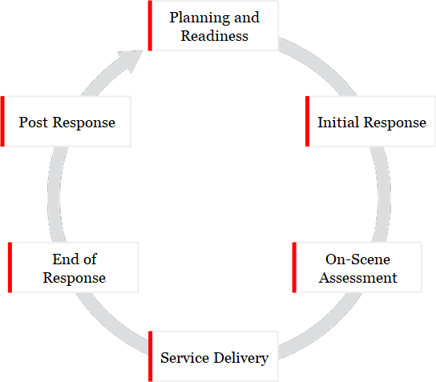
DAT Response Process
4
Notes:
This diagram illustrates the DAT Response cycle. Planning and Readiness in steady state are the foundation of our ability to RESPOND when a disaster occurs.

Slide 6
DAT Response Process
Today's workshop covers:
The Initial Response
The On-Scene Assessment
Service Delivery
The End of the Response
The Post Response follow-up
5
Notes:
Today's workshop will familiarize you with the phases which come into play when Red Cross assistance for a disaster is requested: The Initial Response The On-Scene Assessment Service Delivery The End of the Response The Post Response follow-up

Slide 7
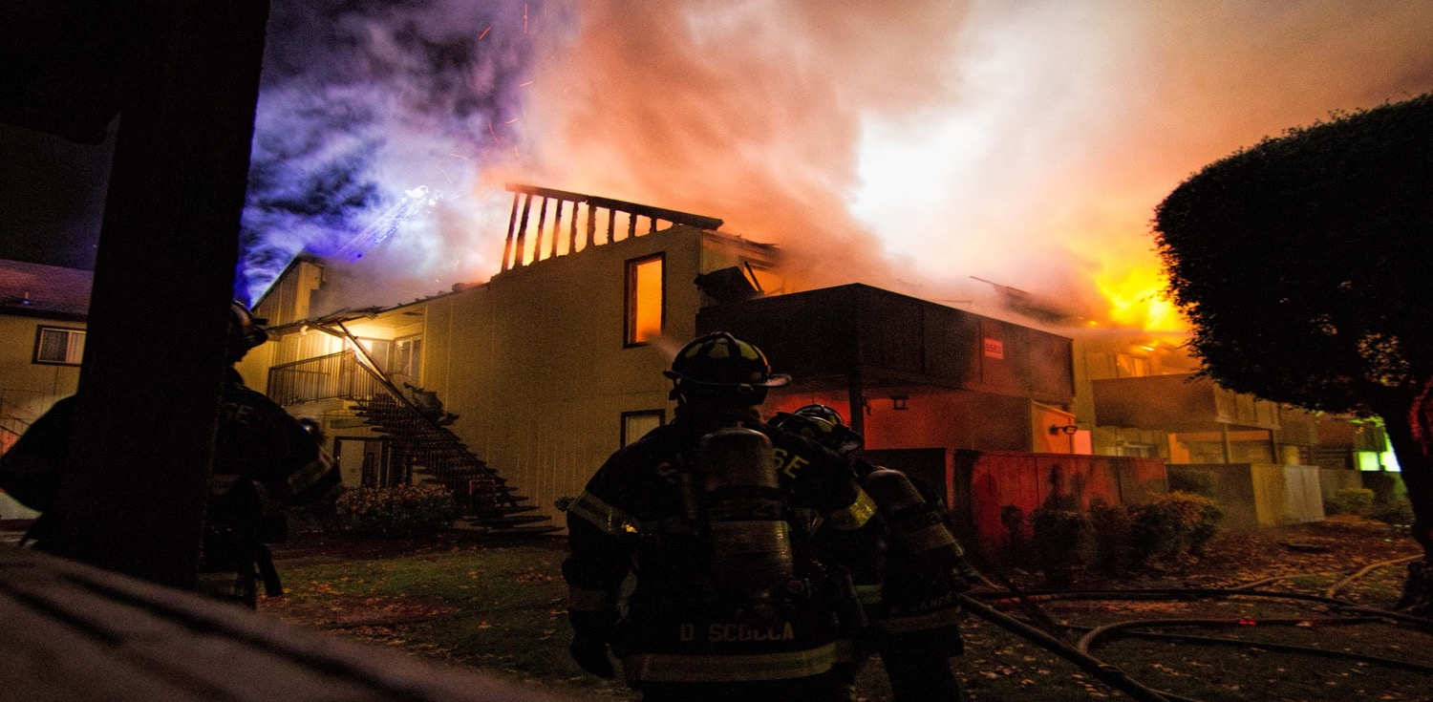
Breaking News:
6

Slide 8
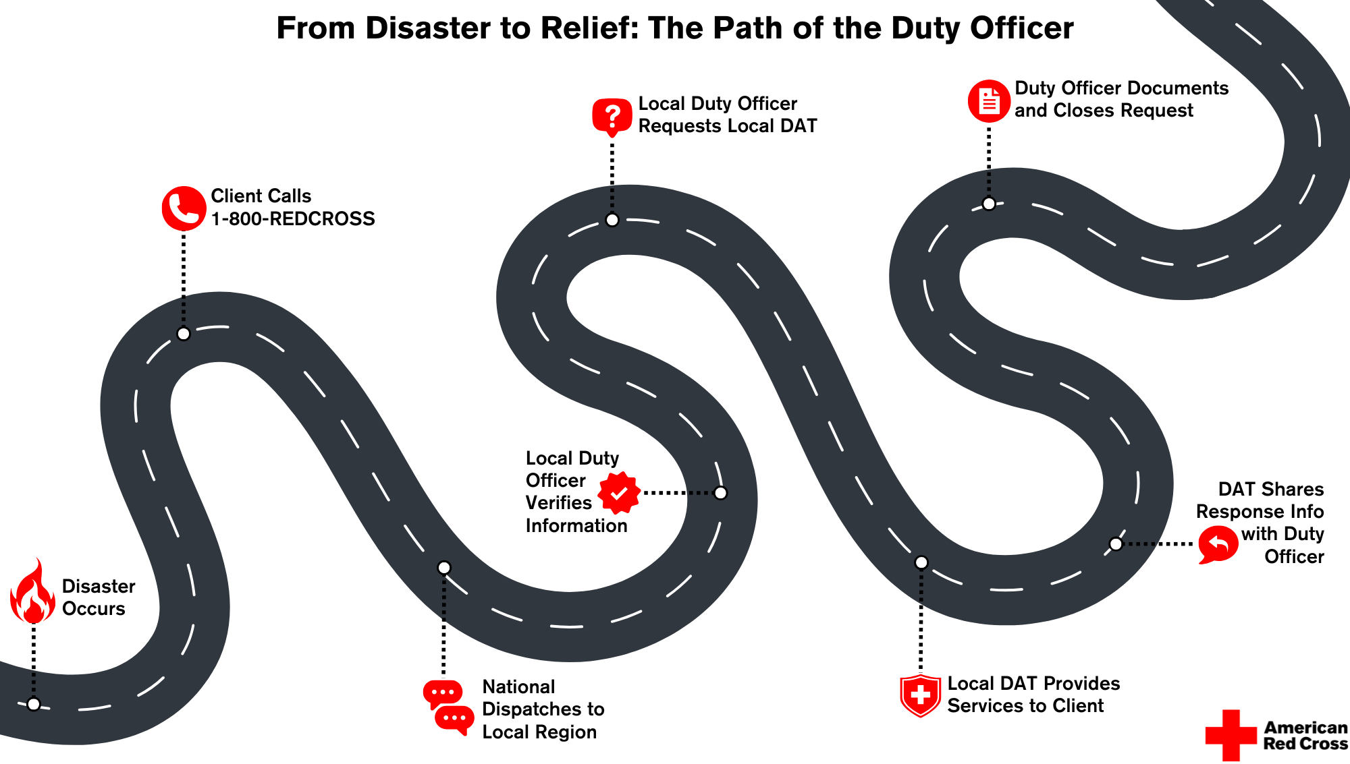
From Disaster to Relief
7

Slide 9
Workflow of a Typical DAT Response
1. Event Occurs
2. DDO Notified
3. Assess Situation
4. Meet Clients
5. Client Intake
6. Provide Assistance
7. Wrap Up
8. Follow Up
Event occurs and Red Cross assistance is requested
DAT Duty Officer evaluates, recruits and dispatches team
On-scene lead assesses situation with first responders
Meet with clients and perform intake in RC Care
Provide assistance based on assessed needs
Wrap up, check out with DDO; Recovery follows up within 72 hours
8
Notes:
INSTRUCTOR: This may be a place to include some details about notification, dispatching, etc. as it occurs in your Territory. This flow chart gives you an idea of the workflow of a DAT response. INSTRUCTOR: please note that this slide builds up step by step; you can move through the steps with mouse clicks. Click 1: EVENT occurs and assistance from the Red Cross is requested Click 2: DAT DUTY OFFICER (DDO) is informed of the request, evaluates the Event and, if a DAT Response is required, will recruit a response team and send them to the scene of the Event. PLEASE NOTE that you may have local protocols for the team to meet before going to the scene. The team will be led by a DAT Supervisor (SV). An EVENT MANAGEMENT system named RC Respond is used by the DDO and responders to manage the workflow of the Event. Click 3: ASSESS SITUATION: the on-scene lead (a DAT SV or DAT MN) will take the lead to become familiar with the situation (generally by talking to the on-scene first responder) and will identify the affected clients. Click 4: MEET WITH CLIENTS Click 5: CLIENT INTAKE: In-depth discussion with the Client. How are they and their family affected? What are their Immediate Needs? Once the DAT responder has a clear picture then the DAT will perform online Client Intake in the RC Care system. Click 6: PROVIDE ASSISTANCE Click 7: WRAP UP: at the end of the response all responders should check out with the DAT Duty Officer when they are safely off-scene and/or home Click 8: Clients should receive a follow up communication from the Recovery team within 72 hours. PLEASE NOTE: For Safety reasons during a response all responders should be in contact with the DAT Duty Officer and/or ensure that the DAT Supervisor for the response notifies the DDO of the whereabouts of all responders.

Slide 10

Preparing to Respond
DAT "Go Kit":
Fully charged phone
Able to access internet
Flashlight
Pens
Clipboard
Notepad
Copies of forms and job tools
Snacks
Other locally recommended or required items
9
Notes:
As a DAT Specialist, you will want to be ready to deploy to a disaster Event without delay should you be called. Most experienced DAT responders have a "go kit" at the ready or already in the trunk of their vehicle. Here are some examples of items to have at the ready. Talk to other experienced team members to get an idea of what they have found to be important. Additional "Go Kit" information can be found on your DAT Onboarding Checklist.

Slide 11
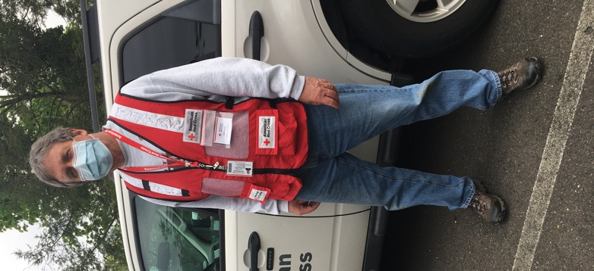
Proper Attire
Safe and Appropriate Attire
Mask (if necessary due to local conditions)
Red Cross ID
Weather-applicable clothing
Red Cross Vest
Closed-toed, sturdy shoes or boots
10
Notes:
Let's take a look at what you should wear: Remember, you are representing the American Red Cross whenever you respond as a DAT member. Please be mindful of how you present yourself to others. The Volunteer Handbook states that volunteers are expected to dress appropriately for the environment you're working in, maintain good grooming and personal cleanliness. We ask that you not wear clothing with political, religious, or controversial messages while on duty. The Handbook also includes the Red Cross policy on weapons and states that employees and volunteers are prohibited from possessing or using weapons while conducting Red Cross business including riding in a Red Cross owned vehicle.

Slide 12

Initial Response
DAT Standards:
DAT Duty Officer is always on call: receives and confirms disaster notification details, promptly assembles Disaster Action Team to respond
Disaster Action Teams arrive on scene and make contact with client(s) within two hours of notification
A minimum of two DAT responders are available for each Disaster Action Team response
Disaster Action Teams respond to 100% of events when Red Cross action is requested, appropriate, and safe
11
Notes:
CLICK to reveal a text box. Read the following: Our DAT Program has some key performance Standards to achieve. Key among these are: A DAT Duty Officer is always on call; the DDO receives and confirms disaster notification details, makes initial contact with the client and promptly assembles Disaster Action Team to respond. Disaster Action Teams arrive on scene. Disaster Action Teams make initial contact with client(s) within two hours of receiving notification. A minimum of two DAT responders, to include at least one DAT Supervisor, are available for each Disaster Action Team response. Disaster Action Teams respond to 100% of events when Red Cross action is requested, when it is appropriate, and when it is safe for workers to respond.

Slide 13
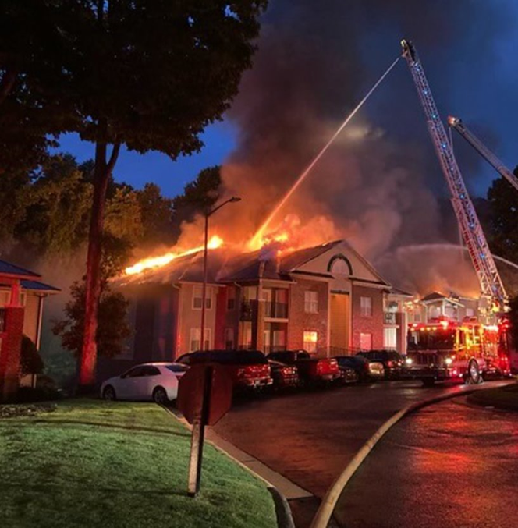
What You May Encounter
Fire department activity
Noise, water, smoke, smell, ash, etc.
Possibly distraught clients
Injured or hospitalized people or pets
Fatalities
Bystanders
Press
Disaster scales up
12
Notes:
While there are certain things you can expect on every response, no two DAT responses are the same. Disaster scales ups: for some DAT Responses the size of the Event may be larger than can be readily managed by a small Disaster Action Team or the Event may grow in size. We will discuss how such Events scale up later during this Workshop.

Slide 14
On Scene Safety
Notify DAT Duty Officer when you arrive on scene (by phone, SMS, or using RC Respond)
Minimum of two Red Cross workers must be present at all in-person responses
Recommended to agree on a meeting location in advance with other team members
Do not walk in water or near burning buildings
Do not enter any damaged property
If you feel uncomfortable or threatened, or the scene becomes unsafe, leave immediately and notify other on-scene responders and the DAT Duty Officer
If scene becomes unsafe, do not hesitate to call 911
13
Notes:
INSTRUCTOR: Talk about each bullet point and emphasize that Safety is a TOP priority.

Slide 15
On Scene Safety (cont.)
It may take some time to support all clients in need
Be sensitive to client frustration — they are likely upset with the situation, not with you
All team members should leave together when response is complete
Notify DAT Duty Officer when you leave the scene ("Off-scene") and when you are safely off the response ("Complete") — by phone, SMS, or using RC Respond
Do NOT self-deploy at any time
14
Notes:
INSTRUCTOR: review these bullet points. You may wish to add details around safety carried out by your region/territory.

Slide 16
On-scene Assessment
15
Notes:
We will now discuss the On-scene Assessment phase of a DAT response. REMEMBER: safety of DAT responders is the first priority when arriving on scene and during all on-scene phases of the Response. The on-scene assessment starts with an "Initial Assessment." The DAT Supervisor generally meets with the on-scene Incident Commander, if present, to review the situation and gain any additional information not previously provided or available. The DAT Supervisor will work through the Incident Commander (or designee) to briefly explain how the Red Cross can assist and to obtain additional information including: - Who the affected clients are - Where the affected clients are located - Any fatalities or injuries not previously reported - Whether there are any children, elderly clients, pets, or any known access and functional needs - Verifying event details including the extent of damage and whether the dwelling is safe for return - Any other details, such as information about arson or law enforcement investigations, safety issues, or conversations with building management If there is no longer a responding Emergency Service Agency on-scene, the DAT Supervisor will guide the team through the Initial Assessment. BUT FIRST, let's start with some very important Do's and Don'ts.

Slide 17
What TO DO at a Response
Situation | What to Do
Safety | Follow all DAT safety protocols
Meeting with Clients | LISTEN to client(s) to understand how they were impacted and to ascertain their needs. Formally identify & verify the clients and residency. Evaluate disaster-related damage. Identify emotional, physical & material needs (incl. access and functional needs and pets).
Confidentiality | At all times maintain client confidentiality
Stress | Look for signs of stress or fatigue in clients & other responders. Mental Health services are offered to clients during case opening and are also available to responders if necessary.
16
Notes:
INSTRUCTOR: review each of these bullet points. Add detail/examples.

Slide 18
What TO DO at a Response (cont.)
Situation | What to Do
If approached by the press | Direct all inquiries to the DAT Supervisor in charge of the response. Limit responses to: "The Red Cross is here to provide help to anyone affected by this event."
Coordinating with first responders | Stay alert to your surroundings and the activities of first responders. Do not obstruct fire department activities. Stay away from fire hoses (may be under high pressure) and other fire department equipment and vehicles.
17
Notes:
INSTRUCTOR: review each of these bullet points. Add detail/examples.

Slide 19
What NOT to Do at a Response
DO NOT: | Additional Info
Take any risks | If you feel unsafe: Inform DAT Supervisor / DAT Duty Officer. Do not approach the scene.
Approach the scene alone | Safety: 2 on-scene responder minimum
Take the lead interviewing clients unless authorized by DAT SV | You may be the "Second Responder" for the purposes of Client Intake in RC Care
Discuss the event with bystanders
Promise specific assistance | After assessing client needs, DAT Supervisor identifies assistance to be provided
18
Notes:
INSTRUCTOR: Review the "Do Nots" one by one and add comments or examples. Please EMPHASIZE that the DAT Supervisor/Manager is the only on-scene DAT member who is authorized to commit assistance to the client so a DAT Specialist should be very careful not to do so. REMEMBER: Just because you have been dispatched to the scene, doesn't automatically mean you will be opening cases or that people will qualify for assistance.

Slide 20
What NOT to Do at a Response (cont.)
DO NOT: | Additional Info
Be alone with youth (under 18) | Required: minimum of 3 people present — 2 adults, 1 or more youths
Provide transportation to client(s) | Personal car or Red Cross vehicle. If the client needs transportation, it can be arranged through a cab company.
Leave an Event without informing DAT Supervisor and/or DAT Duty Officer | There may be further tasks to do. This is a safety issue.
19
Notes:
INSTRUCTOR: Review the "Do Nots" one by one and add comments or examples. Also mention: Youth under 18 years of age are NOT ELIGIBLE to be DAT responders.

Slide 21
Service Delivery
20
Notes:
Now we will move to the Service Delivery phase which is the core of a DAT response. There are some Program Standards to which we must adhere. In summary: Minimum services include provision of water, comfort kits, snacks, blankets, disaster mental health and disaster health services, and accessible information. DAT responders interview the client(s), collect information, determine if the extent of damage to the client residence, and provide appropriate assistance in alignment with the Casework and Recovery Planning Standards and Procedures. We will go into details about these but FIRST we will talk about the Client Care Program which is the basis for delivering resources and assistance to clients at the disaster scene and during the subsequent follow up by the Recovery team.

Slide 22
The Client Care Program (CCP)
21

Slide 23
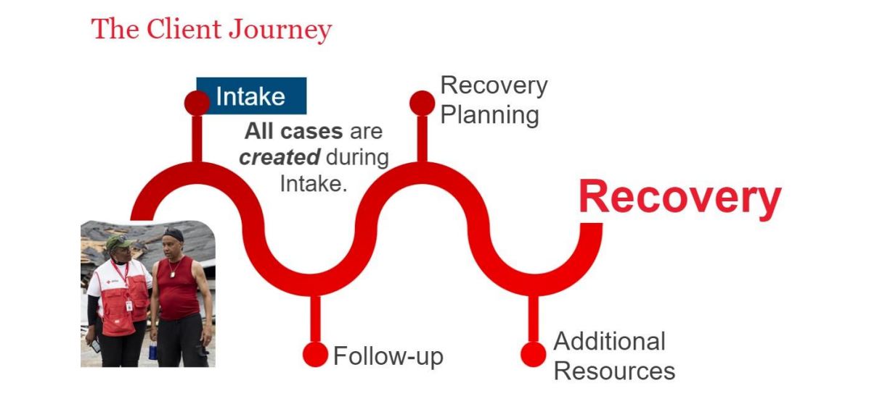
The Client Care Program (CCP)
22
Notes:
INSTRUCTOR: Please review the points below. The American Red Cross CLIENT CARE PROGRAM: Every client will receive similar types of recovery support from Red Cross regardless of the disaster or unique disaster-caused needs. The first step with the Client Care Program is Intake. All client cases in the RC Care system are created during Intake. As a DAT Responder you will participate in the Intake process for eligible clients with whom you meet during the disaster response. Basic client information is collected to identify disaster-caused needs, determine eligibility, and provide financial assistance and other resources to help with recovery. Meeting with a client during intake also sets the stage for Recovery and the information you collect during the intake interview will be used throughout the Client Journey towards Recovery. We will discuss Intake in more detail shortly. We strive for Continuous Improvement to all of the Disaster Cycle Services policies and procedures. To ensure this the Red Cross encourages client feedback. Primary clients will receive a client satisfaction survey when their case is closed. REMEMBER: the client experience during a DAT response is usually the most important one in determining their overall satisfaction with the Red Cross.

Slide 24
Eligibility
Client Care Program Eligibility
Assistance is provided to all clients who have experienced a disaster.
The type of assistance depends on:
A confirmed disaster Event
The client's disaster-caused needs
A detailed damage assessment (DDA) of their residence
Confirmation of client address and identity
Details may be found in the "Client Care Program Standards and Procedures"
23
Notes:
The Red Cross approves applications for the Client Care Program when all the program-specific eligibility requirements have been met. You will learn the details regarding eligibility when you take the "Client Care Program: Disaster Client Intake" course and two related courses: "Detailed Damage Assessment for Disaster Action Team Response Operations" and "Document Review for Intake Workers". In summary: Assistance is provided to all clients who have experienced a disaster. The type of assistance depends on: - A confirmed disaster - The client's disaster-caused needs - A detailed damage assessment (DDA) of their residence - Confirmation of client address and identity Sometimes the primary client will need to provide documentation such as proof of identity and/or address. In these instances, the review of documents is done in-person by DAT responders. As a DAT Specialist you may participate in the CONFIRMATION of: - The Event, if it has not been fully confirmed by an Emergency Management Agency official such as a Fire Fighter - The extent of Damage to the residence - The Client ID and proof of residency at the affected property To record these confirmations, you will receive a code generated by RC Care during the Intake. The Token will be entered into the Client's RC Care case. Entry of the code/Token represents your Electronic Signature confirming that you fully interacted with the client during the Intake interview. By entering your Token in the case, YOU are attesting that the facts of the case are true and correct to best of your knowledge.

Slide 25
Resource and Referral Cases
For clients not eligible for financial assistance (due to DDA classification or because an eligible client declines):
Referrals and resources such as comfort kits, blankets, clean-up kits may be provided
Financial Assistance for Disaster Health Services, Disaster Mental Health Services, and Disaster Spiritual Care can always be provided if there is an expressed need regardless of damage assessment classifications
This is administered by DHS, DMH, or DSC and not by DAT
24
Notes:
When the DDA for a DAT event does not meet the criteria for financial assistance, clients are still eligible for the other services that ALL clients may access. We still open a case in RC Care, since financial assistance is not triggered. Resource and Referral Cases: For clients who are not eligible for financial assistance due to DDA classification or because an eligible client declines financial assistance. Referrals and resources such as comfort kits, blankets, clean-up kits may be provided. DAT workers will provide some of these items: Comfort Kits (which contain personal hygiene items such as: soap, toothbrush and toothpaste, wash-cloth etc.), blankets, snacks and water and stuffed toys for children. DAT Supervisors and Service Associates should carry a stock of these as part of their "Go Kit". If you are a regular responder, talk to your DAT Coordinator to obtain a stock that you can also carry. Financial Assistance for Disaster Health Services, Disaster Mental Health Services, and Disaster Spiritual Care can always be provided if there is an expressed need regardless of damage assessment classifications; this will be determined by and administered by the appropriate Disaster Health Services, Disaster Mental Health or Disaster Spiritual Care workers and NOT by DAT.

Slide 26
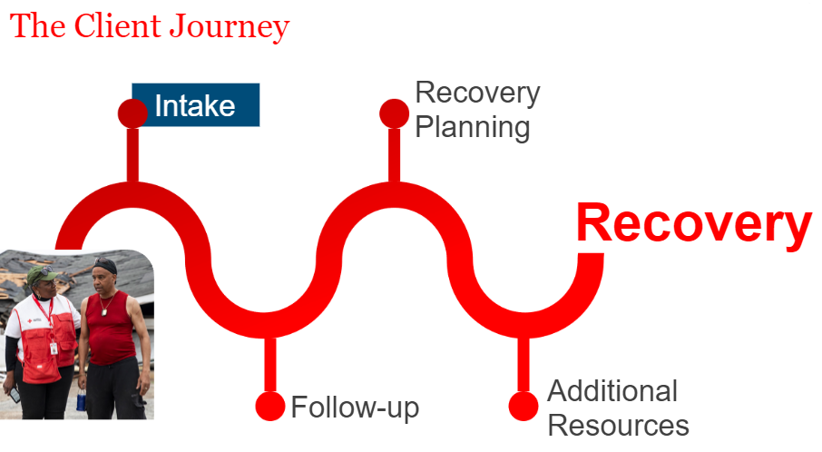
The Client Care Program Services & Assistance
25
Notes:
As mentioned, a few minutes ago, the first step with the Client Care Program is INTAKE. All RC Care client cases are created during intake. Disaster Action Team, or DAT responders, caseworkers, partners, or other trained individuals can assist a client with their Client Care Program application during intake. Basic client information is collected to identify disaster caused needs, determine eligibility, and provide financial assistance and other resources to help with recovery. Let's talk about Intake in more detail.

Slide 27
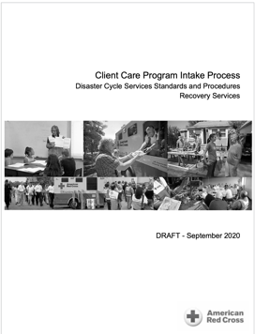
Intake
The DAT will:
Interview clients
Determine eligibility for assistance
Confirm and record client details using RC Care Client Intake
Requires two Red Cross responders with access to RC Care: one with "full intake access" and one with at least "Intake Trainee" access
Please complete the 90-minute EDGE Course: "Client Care Program: Disaster Client Intake"
26
Notes:
INSTRUCTOR: Please read these points fully with particular emphasis on the two comments under "Please Note." Interviewing Clients: The initial interview is key to understanding clients' concerns and needs and thus identify the ways in which the Red Cross can assist them with their recovery. Later during this workshop, we will discuss in detail how to approach the client interview at a disaster scene. As well as gaining as complete a picture as possible of the situation, it also gives the DAT the information needed to complete a Client Intake in the RC Care system. During the interview, DAT will inform clients about Red Cross services and set clear expectations regarding what the services and assistance the Red Cross can provide. You can learn more about this in the "Client Care Intake Process Standards and Procedures" and when you take the EDGE Course: "Client Care Program: Disaster Client Intake". Completion of that course will be necessary before you can obtain access to RC Care in the "Intake Trainee" role. Please note: As a DAT Specialist you may lead the interview of clients under the supervision of a DAT Supervisor or DAT Service Associate once you have completed the necessary training and gained some experience. It is not required that you lead client interviews but, with a little experience, you should be able to do so, and you will find that it is the most important and fulfilling aspect of being a DAT responder. As a DAT Specialist, you are NOT authorized to create a client case in RC Care; you are authorized to support the confirmations just mentioned. The RC Care system will send a communication to you, called a "TOKEN" which is used to register your confirmations.

Slide 28
Individual Disaster Care Services
27
Notes:
During the Intake process, you may identify a client need for one or more of the Individual Disaster Care Services mentioned earlier. These needs can be indicated on one of the RC Care intake screens, and the regional Individual Disaster Care Services teams will follow up with the client within 72 hours. During the intake interview, clients should be made aware of the availability of the IDC services, but it is up to the client if they want to request these services when offered.

Slide 29
Interviewing Clients
The purpose of an interview:
Encourage client(s) to share how household members were affected
Identify resources client can access
Identify the additional assistance needed by client(s) today
Explain what client(s) may expect from the Red Cross
Reassure client of Red Cross confidentiality and right for client to determine with whom information is shared
Set the stage for follow-up casework & recovery planning
28
Notes:
INSTRUCTOR: please read this slide to the attendees. The different points are revealed one-by-one with Mouse Clicks.

Slide 30
Interviewing Clients
When starting the interview…
Introduce yourself… let them know you're a volunteer!
Explain why the Red Cross is there…
To help with immediate disaster-related needs, both physically and emotionally
Reassure client that Red Cross assistance is free
"Hi, my name is [NAME]. I'm a volunteer with the Red Cross and we're here to help you."
"The American Red Cross prevents and alleviates human suffering in the face of emergencies by mobilizing the power of volunteers and the generosity of donors."
29
Notes:
INSTRUCTOR: please read this slide to the attendees. The different points are revealed one-by-one with Mouse Clicks. Remind attendees always to have the MISSION of the American Red Cross top of mind. Red Cross Services: Begin by explaining the mission of the Red Cross and Casework and Recovery Planning assistance to the client. Promote realistic client expectations. The Red Cross can always offer health and mental health services (with appropriate approval), information about available resources, information about disaster preparedness, referrals to resources, bulk items, and other response assistance to disaster affected community members.

Slide 31
Interviewing Clients
During the interview, maintain your focus on client needs by:
Actively listening
Showing empathy & compassion
Maintaining confidentiality
Not over-identifying with the client
Remaining neutral
REMEMBER: It is an interactive discussion, not a transaction or an interrogation!
30
Notes:
INSTRUCTOR: please read this slide to the attendees. The different points are revealed one-by-one with Mouse Clicks.

Slide 32
Interviewing Clients
To provide an excellent client experience:
Maintain compassion
Be respectful
Provide empathy and understanding
Make the client feel seen and heard
Help to remove obstacles
Set expectations and explain the process: what Red Cross can do, what comes next
Embody the Mission: we are all responsible to alleviate suffering
31
Notes:
Our goal is to provide clients with the best possible experience on a day which may be one of the worst they have experienced. INSTRUCTOR: please read this slide to the attendees. The different points are revealed one-by-one with Mouse Clicks.

Slide 33
Interviewing Clients
Additional techniques…
Be aware of client needs; look out for unspecified needs
Let the client tell you; do not make assumptions
Allow silence; give the client time to explain
Talk to the client, not your paperwork/device
Avoid interrupting and distractions
Focus on client's state of mind
Be mindful of body language (theirs & yours)
Be mindful of the presence of children
Paraphrase to ensure understanding
32
Notes:
INSTRUCTOR: please read this slide to the attendees. The different points are revealed one-by-one with Mouse Clicks. As you read through, please consider using the additional words below: - Be aware of the client's needs. Take note of the surrounding circumstances, the timing of questions and answers, and any cultural factors that might help identify unspecified needs. - Talk to your client, not to your papers or your keyboard. - Avoid interrupting and distractions. - Focus on the client's state of mind. If the client becomes emotional and does not want to continue the interview, offer to take a break. If necessary, reschedule the interview. - Be mindful of the client's body language and your own. - Be mindful of the presence of children. If a child is preventing an interview from progressing, be sensitive and patient. Many adults and children do not wish to be separated from each other during or after a time of crisis. - Treat each client as an individual. Respect and relate to each client individually based on the client's circumstances and specific needs and concerns. Your ability to avoid making any assumptions is especially important. - Paraphrase what the client has said; do this aloud when you take notes.

Slide 34
Interviewing Clients
Remember…
Concern
Comfort
Calm
Show empathy and compassion. Encourage clients to tell their story.
Offer water or a snack. Do not rush. Move to a private location if possible.
Be patient. Avoid interruptions. Set boundaries for the relationship.
Identify any critical needs:
Arrange for immediate health/mental health needs right away (for emergencies dial 911)
Assess communication needs (hearing challenges, translation, etc.)
33
Notes:
INSTRUCTOR: please reveal the different points with Mouse Clicks. Use the additional wording provided below: Concern: Show empathy and compassion. Encourage the client to tell their story so you learn their priorities. Remain neutral while supporting the client's recovery and maintain client privacy and confidentiality. Comfort: Make clients comfortable by offering water or a snack if available. Do not rush your introduction or approach. If you are not in a private or comfortable location, ask whether the client would like to move to one, when possible. Respect the client's circumstances, specific needs and concerns and notice cultural factors. Calm: Focus on the client and avoid interruptions and distractions. Be patient. Be aware that many adults and children may wish to remain together during or after a time of crisis. Set boundaries for the relationship by not sharing your personal experiences. Simply being present and caring is a very big part of our service and should not be underestimated. Often a calming presence will help the client. For some clients, it may be their first time asking for help from any agency. Critical Needs: Arrange for any immediate health or mental health needs to be addressed right away. Assess communication needs (for example, hearing challenges, foreign languages) for each primary client. Do you need an interpreter?

Slide 35
Interviewing Clients
Assessing clients' immediate disaster-related needs:
Do they have a safe place to stay tonight?
Do they have any immediate basic needs?
What is the "Damage Assessment" for their residence?
Replacement prescriptions, eyeglasses, other health needs
Mental health support
Do you have your ID, wallet, keys, etc.?
Have you contacted your insurance company, landlord, school, etc.?
Any other needs? (Pets, transportation, referrals, etc.)
Document highlights of interview in narrative (in RC Care or on Client Intake Worksheet): Be succinct, stick to facts, do NOT include confidential medical information.
34
Notes:
INSTRUCTOR: please read this slide to the attendees. The different points are revealed one-by-one with Mouse Clicks. Follow up by reading the additional text below: Ask yourself: - What is the client telling you about the client needs? - What can you see about the client needs? - What personal resources do the clients have? Helping the client determine which helpful personal resources they may access, such as family, friends, insurance, social networks, religious affiliation, school, military or employee programs. Using the client's own resources allows the client to regain independence during recovery. When no personal resource is available, collaborating with the client to determine which other resources are accessible that will best meet the client's needs. These should be: immediately available, easily accessible, comfortable for the client, conducive to the client's recovery. Assess how many cases to create, based on household composition. For the purposes of providing Red Cross assistance, a family is all of the members of a household that will recover together. Be guided by the DAT Supervisor or Service Associate. Identify a primary client for each case.

Slide 36
Interviewing Clients
All Red Cross workers supporting the Recovery Services Client Care Program are responsible for:
Keeping clients at the center of decision-making
Ensuring services are delivered with compassion and professionalism
Delivering services that are culturally appropriate and equitable
Following current Client Care Program doctrine
Including client's control over information sharing
35
Notes:
INSTRUCTOR: please read this slide to the attendees. The different points are revealed one-by-one with Mouse Clicks.

Slide 37
End of Response & Post Response
36
Notes:
The Response ends when: 1) The DAT responders have met with a primary client from each family affected by the disaster and have determined the near-term plans for them including: - Having a plan for a safe place to sleep - Access to food and other essentials for the next 24 to 48 hours - Contact with Red Cross Disaster Health Services to address any immediate (but non-urgent) medical needs such as replacement medications and durable medical equipment - Contact with Disaster Mental Health and/or Disaster Spiritual Care if needed 2) All client information has been entered in RC Care. In case of difficulty accessing RC Care on-scene, this must be completed as soon as possible. The DAT responders notify the DAT Duty Officer at completion of response or when a transition is taking place. Either the responders or the DAT Duty Officer will update RC Respond to reflect that all responders are safely off-scene.

Slide 38
After the Response
Ensure you are marked by the DAT Duty Officer as "Off Scene" when you leave the scene and "Complete" when you are off the response
Remember: Client details are confidential
If you have concerns, reach out to the DAT Coordinator or Disaster Program Manager/Specialist
Disaster Mental Health and Health services are also available for volunteers
37
Notes:
If you have been dispatched through RC Respond, make sure you have been marked "off scene" when you leave the scene and "Complete" when you are off of the response by the Duty Officer. INSTRUCTOR: explain how this is done in your Region/Territory. Remember: - Leave scene safely (preferably all together) - Check out with DDO to ensure you are recorded as safely off-scene - If you interviewed clients, make sure that any key information is included in the RC Care case narrative to ensure smooth hand-off to Recovery Casework Remember confidentiality requirements: you should not discuss details of the Event or personal information about the clients unless it is to assist other Red Crossers with the recovery (e.g., information for DHS or Casework). Don't hesitate to reach out to other resources if you have questions or concerns: - DAT Coordinator or Disaster Program Manager for technical questions or guidance - DMH if you have any worries or concerns relating to the Event and how you feel about the response especially if it was stressful - DHS if you have any health concerns relating to what you may have encountered during the response Remember that these resources are available to YOU as a responder as well as to the clients. If you are involved in a response which is complex or stressful, such as one involving serious injuries or death, our Disaster Mental Health team will reach out to check in with you.

Slide 39
Scaling Up a DAT Response
Disaster Action Teams are the first line of response for almost all local disasters.
DAT must be prepared to scale up and/or hand off activities when larger or more complex disasters occur.
Additional elements to be considered:
Workforce – additional responders
Distribution of Emergency Supplies (DES) including comfort kits, stuffed animals, etc.
Feeding or Canteening
More technology resources at the scene
Sheltering for larger displaced populations
Activating Public Affairs (PA) as necessary
Safety precautions
38
Notes:
Scaling Up a DAT Response: Disaster Action Teams are the first line of response for almost all local disaster Events. The DAT must be prepared to scale up and/or hand off activities when larger or more complex disasters occur. The most common DAT response is a single-family fire; the next level of response complexity is likely to be a multi-family event such as an apartment building fire and associated evacuation. Regions are responsible for planning to enable a smooth transition from Disaster Action Team activation to a larger disaster response structure. There are many additional resources that must be considered: - Will we need additional responders? - Do we have enough supplies like comfort kits, stuffed animals, etc.? - Will there be a need for canteening including potentially feeding clients? - Do we need to bring laptops, tables, or hot spots? - Do we need to put a shelter on standby? - Do we need to get Public Affairs involved? - How do we ensure SAFETY of all responders As you progress in your DAT experience and follow the promotion path to DAT Service Associate and, maybe, DAT Supervisor or Manager, you will take additional courses and gain the knowledge and experience to play a key role in scaling up a Response.

Slide 40
Next Steps
Know Your Local Team
RC Care Access
RC Respond
Connect with your local Chapter
Meet your DPM & DPS
Complete DAT Wellness agreement
Complete required training
Get your access set up
Complete training
Sign up for shifts
When are you available?
Don't forget: Get your "DAT Kit" together!
39
Notes:
Your Region and/or Territory should adapt this slide to their requirements. We want you to succeed as a member of the Disaster Action Team in your Chapter. Get connected to your local Chapter - volunteer meetings, connect with your local DPM & DPS. Complete the DAT Wellness agreement. Gather the items you want in your DAT Go Kit. You are expected to complete the required training for the DAT Specialist position which includes RC Care and RC Respond.

Slide 41
10-Minute Break
Feel free to ask any questions

Slide 42

Detailed Damage Assessment
for DAT Operations
41

Slide 43
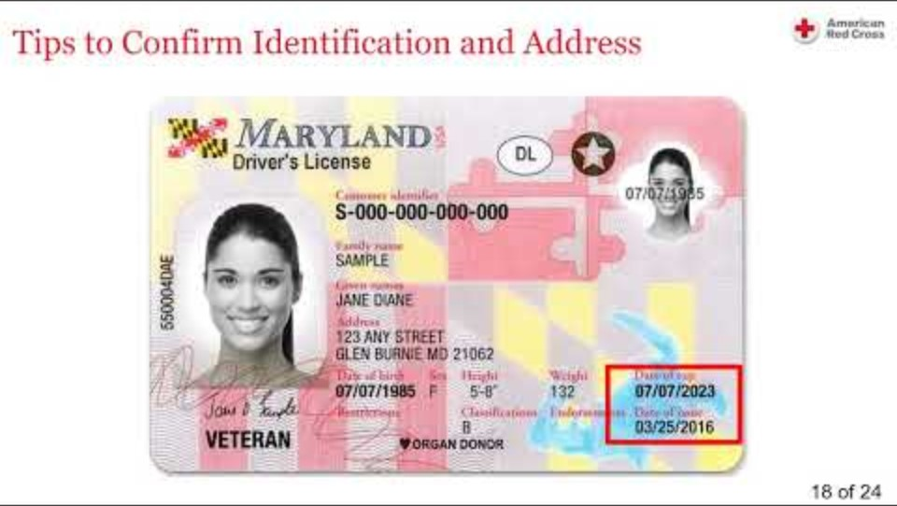
Client Care Program:
Document Review for Intake Workers
42

Slide 44
10-Minute Break
Feel free to ask any questions

Slide 45
RC Respond: Basics
44

Slide 46
RC Respond
RC Respond is the Event Management system used to initiate and manage DAT Events and other Incidents.
RC Respond is used to:
Maintain Schedules for each Region and DAT Territory
Manage Disaster Action Team (DAT) activities through the full response lifecycle
Record Disaster Relief Operation (DRO) Calls
Document other calls to the Red Cross
Access to RC Respond is not required but is highly recommended for all DAT Responders.
45
Notes:
All DAT readiness and response activity is managed in the RC Respond system. All schedules for DAT Responders and Duty Officers are managed in RC Respond. By having workers registered for shifts in schedules, the team can identify who is available to assist clients when a call comes in requesting support. Once a Duty Officer is contacted with the details of the event and they determine a DAT response is appropriate, they will contact DAT members based on their availability and location. Once the DAT member accepts the event assignment, the Duty Officer documents this in RC Respond. It is important that each DAT member keeps the Duty Officer up to date with their activity of when they arrive on scene and off scene either by contacting the Duty Officer directly or through text or email notifications. This is to ensure the Duty Officer can oversee the team's safety. In addition to DAT calls, other calls received to the Red Cross, such as requests regarding large Disaster Relief Operations or offers are also logged in this system.

Slide 47
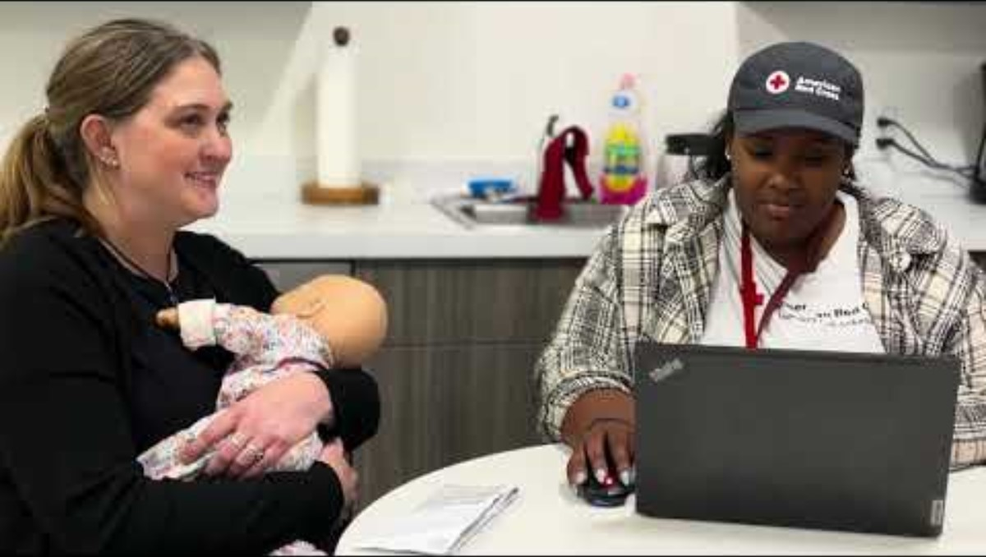
Sample DAT Response
46

Slide 48
Wrapping Up...
Next Steps?
Complete required training courses (RC Care, RC Respond)
Connect with your local team
Get your DAT Go Kit ready
Sign up for shifts in RC Respond
47

Slide 49
Thanks for joining us!
Any final questions or thoughts?
Be sure that you have signed in!

