Slide 2
‘Duty Officer in a Day’ Training

Slide 3
Session 1: DCS: An Overview
&
Disaster Action Team Response Fundamentals

Slide 4

Disaster Action Team (DAT)
Red Cross responds to local disasters 24/7/365:
DATs:
Go to the scene of a disaster to meet with and interview those affected (“clients”)
Help clients feel that the Red Cross cares and can help them begin their recovery
Provide access to recovery resources for immediate needs through the Client Care Program
Includes financial assistance for eligible clients
Notes:
INSTRUCTOR: please read fully the notes below:
What is Disaster Action Team or DAT?
Disaster Action Teams are composed of volunteers trained to offer:
immediate services to disaster-affected individuals and families with compassion, comfort, and care
canteen services for emergency workers.
Disaster Action Teams provide disaster-affected individuals with immediate services that include:
• Prompt contact and explanation of Red Cross assistance;
• Comfort and compassionate support;
• Financial assistance for eligible clients for temporary lodging and other disaster-caused needs
• Distribution of relief supplies;
• Disaster health, mental health, spiritual care, and disability integration assistance or referrals;
• Initial recovery services including referrals and advocacy;
• Canteen services.
As with all Red Cross offerings, these services are made available without discrimination to race, color, creed, religion, gender, gender identity, sexual orientation, national origin, age, disability, veteran or military status, marital status, citizenship status, ancestry, genetic information, genetic conditions or predisposition to certain diseases, or any other characteristics protected by applicable federal, state, tribal, or local law.
The Red Cross seeks to meet the needs of the whole community, including those with access and functional needs, to ensure inclusion of all diverse communities in their Disaster Action Team activities and to abide by the Red Cross fundamental principles.
Disaster Action Teams respond to tens of thousands of disasters a year, of which the vast majority are single- and multi-family fires.
The DAT program emphasizes ON-SCENE responses. “Presence is the Mission”. Clients surveyed after being assisted by the Red Cross give significantly higher satisfaction scores for on-scene DAT responses.
In summary, DAT responders show up to provide compassionate care and comfort on what may be the worst day of the client’s life.

Slide 5
Guiding Principles American Red Cross Disaster Cycle Services
Clients first
Inclusive service delivery
Care and safety of the workforce
Engaged partnership
Good hello/good goodbye
Get to “yes”
Data-driven decision-making
Good stewards of donor dollars and resources
Guiding Principles for Disaster Operations
Notes:
All American Red Cross Disaster Cycle Services operations are guided by this set of Principles :
Clients first
Inclusive service delivery
Care and safety of the workforce
Engaged partnership
Good hello/good goodbye
Get to “yes”
Data-driven decision-making
Good stewards of donor dollars and resources
Provide 1-2 examples. Or ASK the participants to discuss how they understand these Guiding Principles

Slide 6
The DAT Response Process What happens during a DAT response operation

Slide 7
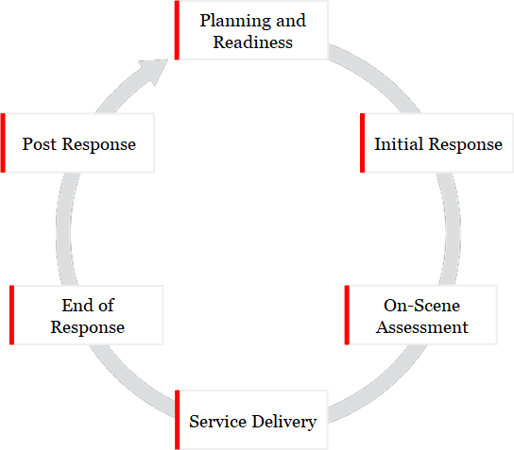
DAT Response Process
Notes:
This diagram illustrates the DAT Response cycle. Planning and Readiness in steady state are the foundation of our ability to RESPOND when a disaster occurs.
ADVANCE TO THE NEXT SLIDE

Slide 8
DAT Response Process
Notes:
Today’s workshop will familiarize you with the phases which come into play when Red Cross assistance for a disaster is requested:
The Initial Response
The On-Scene Assessment
Service Delivery
The End of the Response
The Post Response follow-up

Slide 9
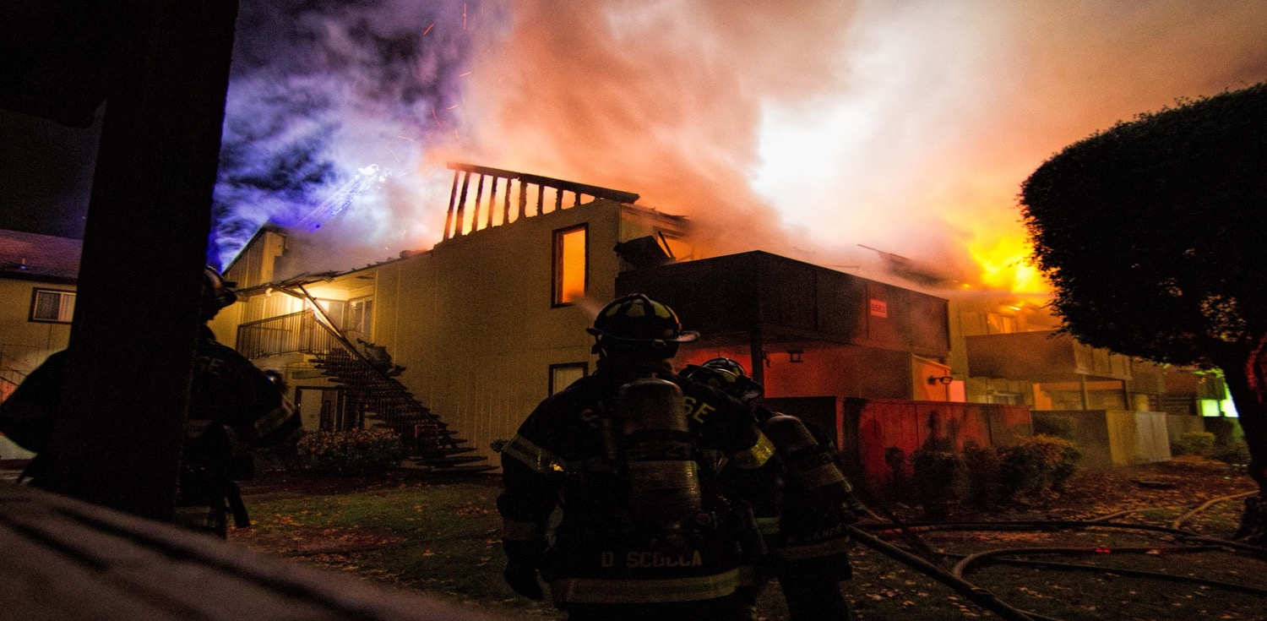
Breaking News:

Slide 10
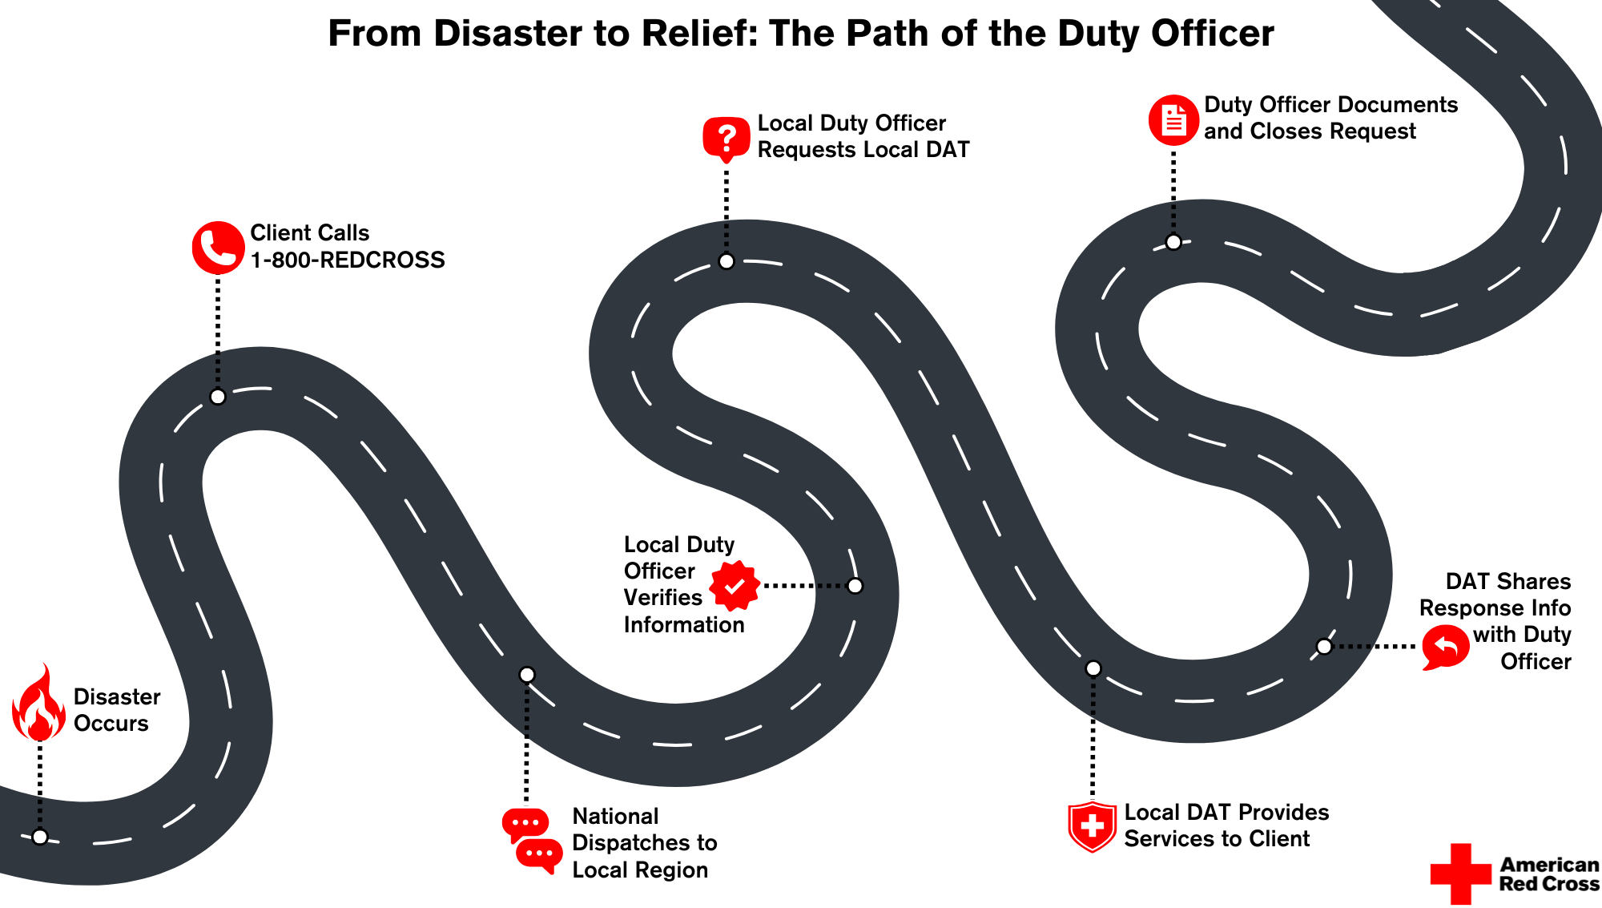

Slide 11




Workflow of a Typical DAT Response
INCIDENT
First responders contact Red Cross
DAT DUTY OFFICER
Evaluates
Recruits team and sends to scene (uses RC Respond)
ASSESS SITUATION
DAT SV talks to first responders and identifies Clients
MEET W/ CLIENTS
CLIENT INTAKE
In depth discussion
PROVIDE ASSISTANCE
Financial assistance
WRAP UP
Return home
FOLLOW UP (72 HRS)
Place to stay
Health, mental / spiritual care
Referrals
Check-out with DAT Duty Officer
Recovery planning based on assessment (DAT)
How is Family affected?
Immediate Needs?
Perform online Client Intake*
Notes:
INSTRUCTOR: This may be a place to include some details about notification, dispatching, etc. as it occurs in your Territory
This flow chart gives you an idea of the workflow of a DAT response. INSTRUCTOR: please note that this slide builds up step by step; you can move through the steps with mouse clicks.
Click 1: EVENT occurs and assistance from the Red Cross is requested
Click 2: DAT DUTY OFFICER (DDO) is informed of the request, evaluates the Event and, if a DAT Response is required, will recruit a response team and send them to the scene of the Event. PLEASE NOTE that you may have local protocols for the team to meet before going to the scene. The team will be led by a DAT Supervisor (SV). An EVENT MANAGEMENT system named RC Respond is used by the DDO and responders to manage the workflow of the Event; we will talk about this in more detail later in this workshop.
Click 3: ASSESS SITUATION: the on-scene lead (a DAT SV or DAT MN) will take the lead to become familiar with the situation (generally by talking to the on-scene first responder) and will identify the affected clients. The DAT SV will assign tasks to the team members
Click 4: MEET WITH CLIENTS and
Click 5: CLIENT INTAKE: In depth discussion with the Client: How are they and their family affected? What are their Immediate Needs? Once the DAT responder has a clear picture then the DAT will perform online Client Intake in the RC Care system
Click 6: PROVIDE ASSISTANCE:
We will discuss these steps in detail later in this workshop
Click 7: WRAP UP: at the end of the response all responders should check out with the DAT Duty Officer when they are safely off-scene and/or home
Click 8: Clients should receive a follow up communication from the Recovery team within 72 hours. The recovery team will use information recorded in the client’s case in RC Care
PLEASE NOTE: For Safety reasons during a response all responders should be in contact with the DAT Duty Officer and/or ensure that the DAT Supervisor for the response notifies the DDO of the whereabouts of all responders especially when they arrive on-scene and when they leave the scene. We will discuss this in more detail later in the workshop.

Slide 12

Preparing to Respond
DAT “Go Kit”:
Fully charged phone
Able to access internet
Flashlight
Pens
Clipboard
Notepad
Copies of forms and job tools
Snacks
Other locally recommended or required items
Notes:
As a DAT Specialist, you will want to be ready to deploy to a disaster Event without delay should you be called. Most experienced DAT responders have a “go kit” at the ready or already in the trunk of their vehicle. Here are some examples of items to have at the ready. Talk to other experienced team members to get an idea of what they have found to be important.
Additional “Go Kit” information can be found on your DAT Onboarding Checklist.

Slide 13
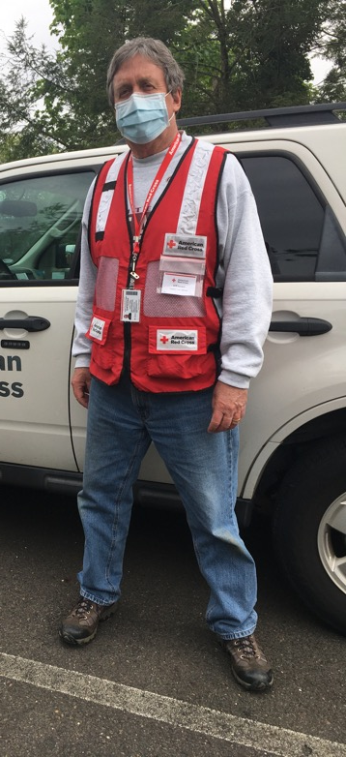
Proper Attire
Mask (if necessary due to local conditions)
Red Cross ID
Weather-applicable clothing
Red Cross Vest
Closed-toed, Sturdy Shoes or Boots
Safe and
Appropriate Attire
Notes:
Let’s take a look at what you should wear:
Remember, you are representing the American Red Cross whenever you respond as a DAT member. Please be mindful of how you present yourself to others.
The Volunteer Handbook states that volunteers are expected to dress appropriately for the environment you’re working in, maintain good grooming and personal cleanliness.
We ask that you not wear clothing with political, religious, or controversial messages while on duty.
The Handbook also includes the Red Cross policy on weapons and states that employees and volunteers are prohibited from possessing or using weapons while conducting Red Cross business including riding in a Red Cross owned vehicle.

Slide 14

Initial Response
DAT Standards:
DAT Duty Officer is always on call:
receives and confirms disaster notification details
promptly assembles Disaster Action Team to respond.
Disaster Action Teams arrive on scene and make contact with client(s) within two hours of notification.
A minimum of two DAT responders are available for each Disaster Action Team response.
Disaster Action Teams respond to 100 percent of events when Red Cross action is requested, appropriate, and safe
Notes:
CLICK to reveal a text box. Read the following:
Our DAT Program has some key performance Standards to achieve. Key among these are:
A DAT Duty Officer is always on call; the DDO receives and confirms disaster notification details, makes initial contact with the client and promptly assembles Disaster Action Team to respond.
Disaster Action Teams arrive on scene.
Disaster Action Teams make initial contact with client(s) within two hours of receiving notification.
A minimum of two DAT responders, to include at least one DAT Supervisor, are available for each Disaster Action Team response.
Disaster Action Teams respond to 100% of events when Red Cross action is requested, when it is appropriate, and when it is safe for workers to respond.

Slide 15
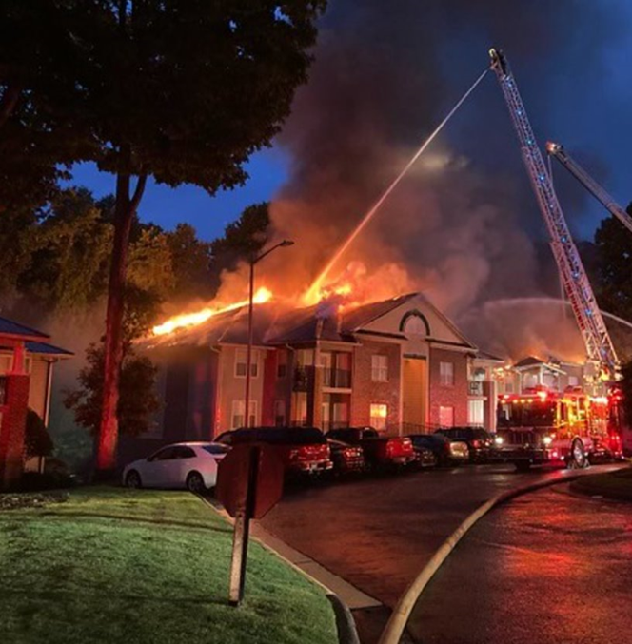
What You May Encounter
Fire department activity
Noise, water, smoke, smell, ash, etc.
Possibly distraught clients
Injured or hospitalized people or pets
Fatalities
Bystanders
Press
Disaster scales up
Notes:
While there are certain things you can expect on every response, no two DAT responses are the same.
Disaster scales ups: for some DAT Responses the size of the Event may be larger than can be readily managed by a small Disaster Action Team or the Event may grow in size. We will discuss how such Events scale up later during this Workshop.

Slide 16


On Scene Safety
Notify DAT Duty Officer when you arrive on scene
By phone, SMS or using RC Respond
Minimum of two Red Cross workers must be present at all in-person responses
Recommended to agree on a meeting location in advance with other team members
Do not walk in water or near burning buildings
Do not enter any damaged property
If you feel uncomfortable or threatened, or the scene becomes unsafe, leave immediately and notify the other on-scene responders and the DAT Duty Officer
If scene becomes unsafe, do not hesitate to call 911
Notes:
INSTRUCTOR: Talk about each bullet point and emphasize that Safety is a TOP priority

Slide 17
On Scene Safety (cont.)
It may take some time to support all clients in need.
Be sensitive to client frustration - they are likely upset with the situation, not with you
All team members should leave together when response is complete
Notify DAT Duty Officer when you leave the scene (“Off-scene) and when you are safely off the response (“Complete”)
By phone, SMS or using RC Respond
Do NOT self-deploy at any time
Notes:
INSTRUCTOR: review these bullet points. You may wish to add details around safety carried out by your region/territory.

Slide 18

On-scene Assessment
Notes:
We will. Now discuss the On-scene Assessment phase of a DAT response
REMEMBER: safety of DAT responders is the first priority when arriving on scene and during all on-scene phases of the Response.
The on-scene assessment starts with an "Initial Assessment”
The DAT Supervisor generally meets with the on-scene Incident Commander, if present, to review the situation and gain any additional information not previously provided or available.
The DAT Supervisor will work through the Incident Commander (or designee) to briefly explain how the Red Cross can assist and to obtain additional information including:
Who the affected clients are
Where the affected clients are located
Any fatalities or injuries not previously reported
Whether there are any children, elderly clients, pets, or any known access and functional needs
Verifying event details including the extent of damage and whether the dwelling is safe for return
Any other details, such as information about arson or law enforcement investigations, safety issues, or conversations with building management
If there is no longer a responding Emergency Service Agency on-scene, the DAT Supervisor will guide the team through the Initial Assessment.
BUT FIRST, let’s start with some very important Do’s and Don’ts

Slide 19



What TO DO at a response…
Mission: To address the immediate basic needs of clients (24-72 hours)
Situation | What to do?
Safety | Follow all DAT safety protocols
Meeting with Clients | LISTEN to client(s) to understand how they were impacted and to ascertain their needs Formally identify & verify the clients and residency Evaluate disaster-related damage Identify emotional, physical & material needs (incl.: Access and Functional needs and pets)
Confidentiality | At all times maintain client confidentiality
Stress | Look for signs of stress or fatigue in clients & other responders. Mental Health services are offered to clients during case opening and are also available to responders if necessary
Notes:
INSTRUCTOR: review each of these bullet points.
Add detail/examples.

Slide 20


What TO DO at a response…
Situation | What to do?
If approached by the press: | Direct all inquiries to the DAT Supervisor in charge of the response Limit responses to: “The Red Cross is here to provide help to anyone affected by this event.”
Coordinating with first responders: | Stay alert to your surroundings and the activities of first responders Do not obstruct fire department activities Stay away from fire hoses (may be under high pressure) and other fire department equipment and vehicles
Notes:
INSTRUCTOR: review each of these bullet points.
Add detail/examples.

Slide 21

What NOT to do at a Response…
DO NOT: | Additional Info
Take any risks | If you feel unsafe: Inform DAT Supervisor / DAT Duty Officer Do not approach the scene
Approach the scene alone | Safety: 2 on-scene responder minimum
Take the lead interviewing clients unless authorized by DAT SV | You may be the “Second Responder” for the purposes of Client Intake in RC Care
Discuss the event with bystanders
Promise specific assistance | After assessing client needs, DAT Supervisor identifies assistance to be provided
Notes:
INSTRUCTOR:
Review the ”Do Nots” one by one and add comments or examples.
Please EMPHASIZE that the DAT Supervisor/Manager is the only on-scene DAT member who is authorized to commit assistance to the client so a DAT Specialist should be very careful not to do so.
REMEMBER Just because you have been dispatched to the scene, doesn’t automatically mean you will be opening cases or that people will qualify for assistance.

Slide 22
What NOT TO DO at a Response…
DO NOT: | Additional Info
Be alone with youth (under 18) | Required: minimum of 3 people present: 2 adults, 1 or more youths
Provide transportation to client(s) | Personal car or Red Cross vehicle If the client needs transportation, it can be arranged through a cab company
Leave an Event without informing DAT Supervisor and/or DAT Duty Officer | There may be further tasks to do This is a safety issue
Notes:
INSTRUCTOR:
Review the ”Do Nots” one by one and add comments or examples.
Also mention: Youth under 18 years of age are NOT ELIGIBLE to be DAT responders

Slide 23
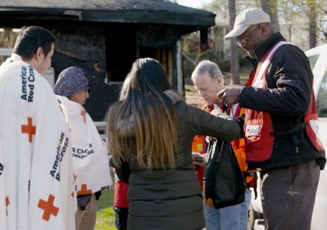
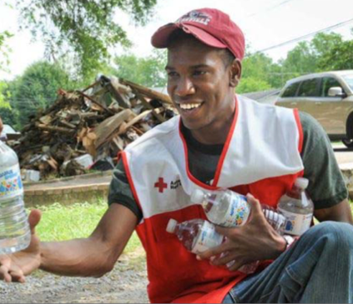
Service Delivery
Notes:
Now we will move to the Service Delivery phase which is the core of a DAT response. There are some Program Standards to which we must adhere. In summary:
Minimum services include provision of water, comfort kits, snacks, blankets, disaster mental health and disaster health services, and accessible information.
DAT responders interview the client(s), collect information, determine if the extent of damage to the client residence, and provide appropriate assistance in alignment with the Casework and Recovery Planning Standards and Procedures.
We will go into details about these but FIRST we will talk about the Client Care Program which is the basis for delivering resources and assistance to clients at the disaster scene and during the subsequent follow up by the Recovery team.

Slide 24
The Client Care Program (CCP)

Slide 25
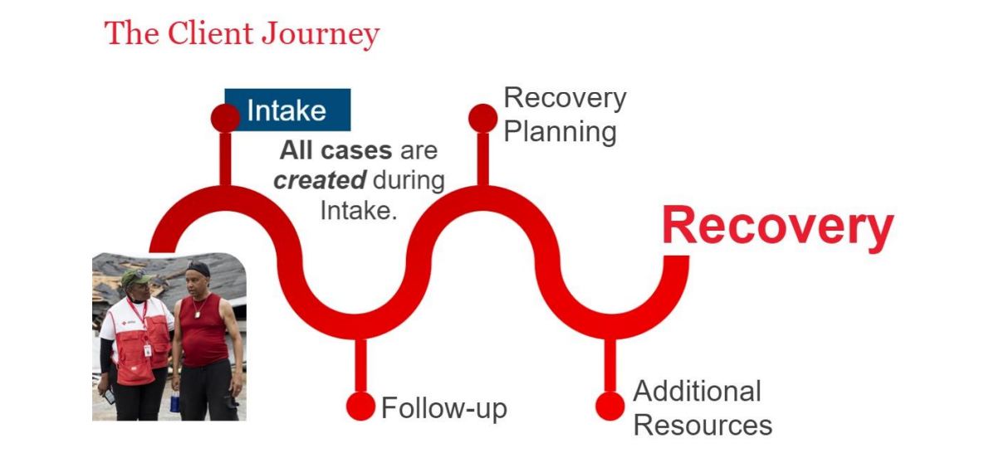
The Client Care Program (CCP)
Notes:
INSTRUCTOR: Please review the points below.
The American Red Cross CLIENT CARE PROGRAM:
Every client will receive similar types of recovery support from Red Cross regardless of the disaster or unique disaster-caused needs.
The first step with the Client Care Program is Intake. All client cases in the RC Care system are created during Intake.
As a DAT Responder you will participate in the Intake process for eligible clients with whom you meet during the disaster response.
Basic client information is collected to identify disaster-caused needs, determine eligibility, and provide financial assistance and other resources to help with recovery.
Meeting with a client during intake also sets the stage for Recovery and the information you collect during the intake interview will be used throughout the Client Journey towards Recovery.
We will discuss Intake in more detail shortly
We strive for Continuous Improvement to all of the Disaster Cycle Services policies and procedures. To ensure this the Red Cross encourages client feedback. Primary clients will receive a client satisfaction survey when their case is closed. REMEMBER: the client experience during a DAT response is usually the most important one in determining their overall satisfaction with the Red Cross.

Slide 26
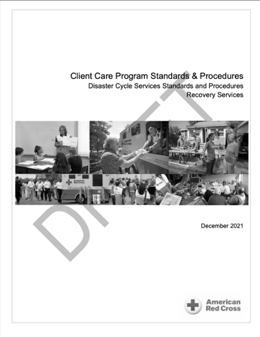
Eligibility
Client Care Program Eligibility
Assistance is provided to all clients who have experienced a disaster
The type of assistance depends on:
A confirmed disaster Event
The client’s disaster-caused needs
A detailed damage assessment (DDA) of their residence
Confirmation of client address and identity
Details may be found in the “Client Care Program Standards and Procedures”
Notes:
The Red Cross approves applications for the Client Care Program when all the program-specific eligibility requirements have been met.
You will learn the details regarding eligibility when you take the “Client Care Program: Disaster Client Intake” course and two related courses: “Detailed Damage Assessment for Disaster Action Team Response Operations” and “Document Review for Intake Workers”.
In summary:
Assistance is provided to all clients who have experienced a disaster.
The type of assistance depends on:
A confirmed disaster
The client’s disaster-caused needs
A detailed damage assessment (DDA) of their residence
Confirmation of client address and identity
Sometimes the primary client will need to provide documentation such as proof of identity and/or address. In these instances, the review of documents is done in-person by DAT responders.
As a DAT Specialist you may participate in the CONFIRMATION of:
The Event, if it has not been fully confirmed by an Emergency Management Agency official such as a Fire Fighter
The extent of Damage to the residence
The Client ID and proof of residency at the affected property
To record these confirmations, you will receive a code generated by RC Care during the Intake.
The Token will be entered into the Client’s RC Care case (you may do this yourself via the “Intake Trainee” role).
Entry of the code/Token represents your Electronic Signature confirming that you fully interacted with the client during the Intake interview
By entering your Token in the case, YOU are attesting that the facts of the case are true and correct to best of your knowledge.
We will look briefly at the Damage Assessment and ID and Residency Confirmations

Slide 27
Resource and Referral Cases
Resource and Referral Cases:
For clients who are not eligible for financial assistance due to DDA classification or because an eligible client declines financial assistance.
Referrals and resources such as comfort kits, blankets, clean-up kits may be provided
Financial Assistance for Disaster Health Services, Disaster Mental Health Services and Disaster Spiritual Care can always be provided if there is an expressed need regardless of damage assessment classifications
This is administered by DHS, DMH or DSC and not by DAT
Notes:
When the DDA for a DAT event does not meet the criteria for financial assistance, clients are still eligible for the other services that ALL clients may access. We still open a case in RC Care, since financial assistance is not triggered.
Resource and Referral Cases:
For clients who are not eligible for financial assistance due to DDA classification or because an eligible client declines financial assistance.
CLICK
Referrals and resources such as comfort kits, blankets, clean-up kits may be provided.
DAT workers will provide some of these items:: Comfort Kits (which contain personal hygiene items such as: soap, toothbrush and toothpaste, wash-cloth etc.), blankets, snacks and water and stuffed toys for children. DAT Supervisors and Service Associates should carry a stock of these as part of their “Go Kit”. If you are a regular responder, talk to your DAT Coordinator to obtain a stock that you can also carry.
CLICK
Financial Assistance for Disaster Health Services Disaster Mental Health Services and Disaster Spiritual Care can always be provided if there is an expressed need regardless of damage assessment classifications; this will be determined by and administered by the appropriate Disaster Health Services, Disaster Mental Health or Disaster Spiritual Care workers and NOT by DAT.

Slide 28
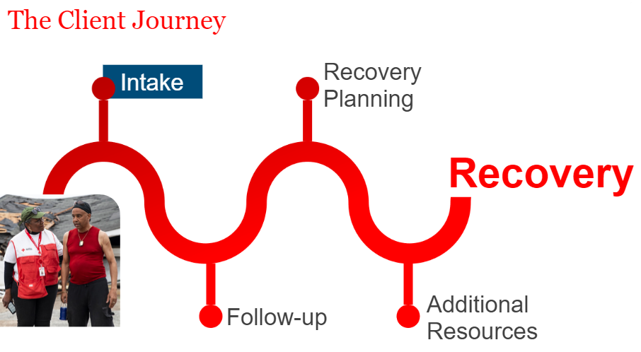
The Client Care Program Services & Assistance
Notes:
As mentioned, a few minutes ago, the first step with the Client Care Program is INTAKE.
All RC Care client cases are created during intake.
Disaster Action Team, or DAT responders, caseworkers, partners, or other trained individuals can assist a client with their Client Care Program application during intake.
Basic client information is collected to identify disaster caused needs, determine eligibility, and provide financial assistance and other resources to help with recovery.
Let’s talk about Intake in more detail

Slide 29
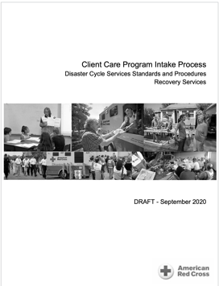
Intake
The DAT will:
Interview clients
Determine eligibility for assistance
Confirm and record client details using RC Care Client Intake
Requires two Red Cross responders with access to RC Care: one with “full intake access” and one with at least “Intake Trainee” access
Please complete the 90-minute EDGE Course: “Client Care Program: Disaster Client Intake”
Notes:
INSTRUCTOR: Please read these points fully with particular emphasis on the two comments under “Please Note”
Interviewing Clients:
The initial interview is key to understanding clients’ concerns and needs and thus identify the ways in which the Red Cross can assist them with their recovery.
Later during this workshop, we will discuss in detail how to approach the client interview at a disaster scene. As well as gaining as complete a picture as possible of the situation, it also gives the DAT the information needed to complete a Client Intake in the RC Care system.
During the interview, DAT will inform clients about Red Cross services and set clear expectations regarding what the services and assistance the Red Cross can provide.
You can learn more about this in the “Client Care Intake Process Standards and Procedures” and when you take the EDGE Course: “Client Care Program: Disaster Client Intake”. Completion of that course will be necessary before you can obtain access to RC Care in the “Intake Trainee” role.
Please note:
As a DAT Specialist you may lead the interview of clients under the supervision of a DAT Supervisor or DAT Service Associate once you have completed the necessary training and gained some experience. It is not required that you lead client interviews but, with a little experience, you should be able to do so, and you will find that it is the most important and fulfilling aspect of being a DAT responder
As a DAT Specialist, you are NOT authorized to create a client case in RC Care; you are authorized to support the confirmations just mentioned. The RC Care system will send a communication to you, called a “TOKEN” which is used to register your confirmations. The exact way to do this is explained in the “Client Care Program: Disaster Client Intake” course.

Slide 30
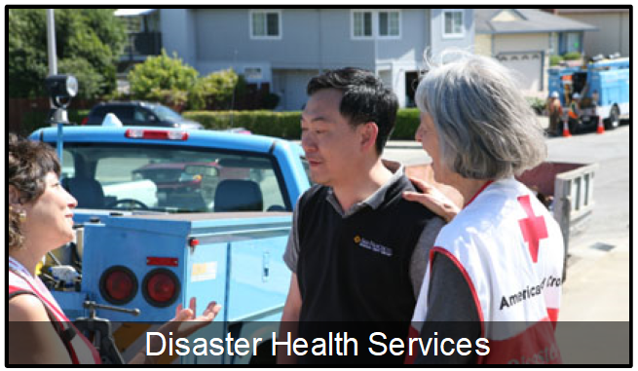
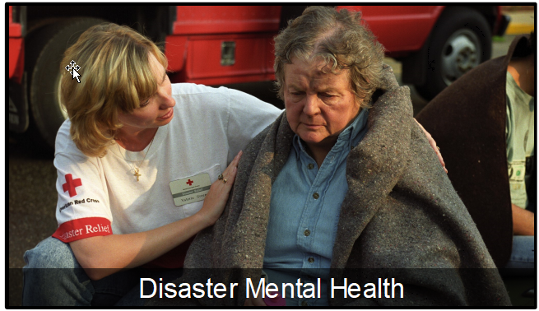

Individual Disaster Care Services
Notes:
During the Intake process, you may identify a client need for one or more of the Individual Disaster Care Services mentioned earlier. These needs can be indicated on one of the RC Care intake screens, and the regional Individual Disaster Care Services teams will follow up with the client within 72 hours.
During the intake interview, clients should be made aware of the availability of the IDC services, but it is up to the client if they want request these services when offered.

Slide 31
Interviewing Clients
Assessing clients’ immediate disaster-related needs:
Do they have a safe place to stay tonight?
Do they have any immediate basic needs?
What is the “Damage Assessment” for their residence?
Replacement prescriptions, eyeglasses, other health needs
Mental health support
Do you have your ID, wallet, keys etc.?
Have you contacted your insurance company, landlord, school etc.?
Any other needs? (Pets. Transportation, Referrals, Etc.)
Document highlights of interview in narrative (in RC Care or on the Client Intake Worksheet):
Be succinct, stick to facts, do NOT include confidential medical information
Notes:
INSTRUCTOR: please read this slide to the attendees. The different points are revealed one-by-one with Mouse Clicks
Follow up by reading the additional text below
Ask yourself:
What is the client telling you about the client needs?
What can you see about the client needs?
What personal resources do the clients have?
Helping the client determine which helpful personal resources they may access, such as family, friends, insurance, social networks, religious affiliation, school, military or employee programs. Using the client’s own resources allows the client to regain independence during recovery.
When no personal resource is available, collaborating with the client to determine which other resources are accessible that will best meet the client’s needs. These should be:
Immediately available,
Easily accessible,
Comfortable for the client,
Conducive to the client’s recovery
Assess how many cases to create, based on household composition. For the purposes of providing Red Cross assistance, a family is all of the members of a household that will recover together. Be guided by the DAT Supervisor or Service Associate.
Identify a primary client for each case

Slide 32
Interviewing Clients
All Red Cross workers supporting the Recovery Services Client Care Program are responsible for:
Keeping clients at the center of decision-making
Ensuring services are delivered with compassion and professionalism
Delivering services that are culturally appropriate and equitable
Following current Client Care Program doctrine
Including client’s control over information sharing
Notes:
INSTRUCTOR: please read this slide to the attendees. The different points are revealed one-by-one with Mouse Clicks

Slide 33
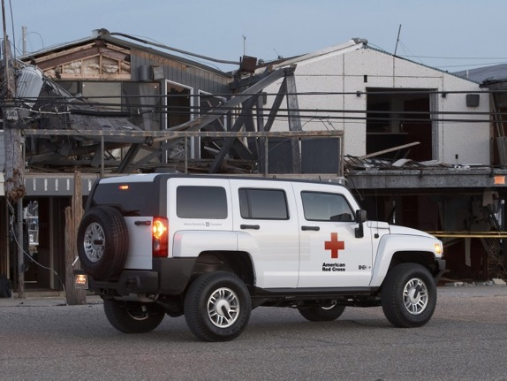
End of Response & Post Response
Notes:
` The Response ends when:
1) The DAT responders have met with a primary client from each family affected by the disaster and have determined the near-term plans for them including:
Having a plan for a safe place to sleep
Access to food and other essentials for the next 24 to 48 hours
Contact with Red Cross Disaster Health Services to address any immediate (but non-urgent) medical needs such as replacement medications and durable medical equipment.
Contact with Disaster Mental Health and/or Disaster Spiritual Care if needed
2) All client information has been entered in RC Care. In case of difficultly accessing RC Care on-scene, this must be completed as soon as possible.
The DAT responders notify the DAT Duty Officer at completion of response or when a transition is taking place. Either the responders or the DAT Duty Officer will update RC Respond to reflect that all responders are safely off-scene.
Let’s review this in a little more detail
NEXT SLIDE

Slide 34




After the Response
Ensure you are marked by the DAT Duty Officer as “Off Scene” when you leave the scene and "Complete" when you are off the response
Remember: Client details are confidential
If you have concerns, reach out to the DAT Coordinator or Disaster Program Manager/Specialist
Disaster Mental Health and Health services are also available for volunteers
Notes:
If you have been dispatched through RC Respond, make sure you have been marked "off scene" when you leave the scene and "Complete" when you are off of the response by the Duty Officer. This can either be done by the DDO or yourself if you have access to the RC Respond event management system.
INSTRUCTOR: explain how this is done in your Region/Territory
Remember
Leave scene safely (preferably all together)
Check out with DDO to ensure you are recorded as safely off-scene
If you interviewed clients, make sure that any key information is included in the RC Care case narrative to ensure smooth hand-off to Recovery Casework
Remember confidentiality requirements: you should not discuss details of the Event or personal information about the clients unless it is to assist other Red Crossers with the recovery (e.g., information for DHS or Casework)
Don’t hesitate to reach out to other resources if you have questions or concerns.
DAT Coordinator or Disaster Program Manager for technical questions or guidance
DMH if you have any worries or concerns relating to the Event and how you feel about the response especially if it was stressful
DHS if you have any health concerns relating to what you may have encountered during the response.
Remember that these resources are available to YOU as a responder as well as to the clients.
If you are involved in a response which is complex or stressful, such as one involving serious injuries or death, our Disaster Mental Health team will reach out to check in with you.

Slide 35
Scaling Up a DAT Response
Disaster Action Teams are the first line of response for almost all local disasters.
DAT must be prepared to scale up and/or hand off activities when larger or more complex disasters occur.
Additional elements to be considered
Workforce – additional responders
Distribution of Emergency Supplies (DES) including comfort kits, stuffed animals, etc..
Feeding or Canteening
More technology resources at the scene
Sheltering for larger displaced populations
Activating Public Affairs (PA) as necessary
Safety precautions
Notes:
Scaling Up a DAT Response
Disaster Action Teams are the first line of response for almost all local disaster Events.
The DAT must be prepared to scale up and/or hand off activities when larger or more complex disasters occur.
The most common DAT response is a single-family fire; the next level of response complexity is likely to be a multi-family event such as an apartment building fire and associated evacuation. Our Disaster Cycle Services organization always needs to be prepared to scale our resources, both workers and stuff!
Regions are responsible for planning to enable a smooth transition from Disaster Action Team activation to a larger disaster response structure. This requires setting expectations for Disaster Action Teams that are responsible for delivering assistance within their territory until regional leadership assumes control of the Disaster Action Team response.
CLICK
There are many additional resources that must be considered. Here are some examples:
Will we need additional responders?
Do we have enough supplies like comfort kits, stuffed animals, etc..?
Will there be a need for canteening including potentially feeding clients?
Do we need to bring laptops, tables, or hot spots?
Do we need to put a shelter on standby?
Do we need to get Public Affairs involved?
How do we ensure SAFETY of all responders
As you progress in your DAT experience and follow the promotion path to DAT Service Associate and, maybe, DAT Supervisor or Manager, you will take additional courses and gain the knowledge and experience to play a key role in scaling up a Response.

Slide 36
Session 2: Duty Officer Fundamentals

Slide 37
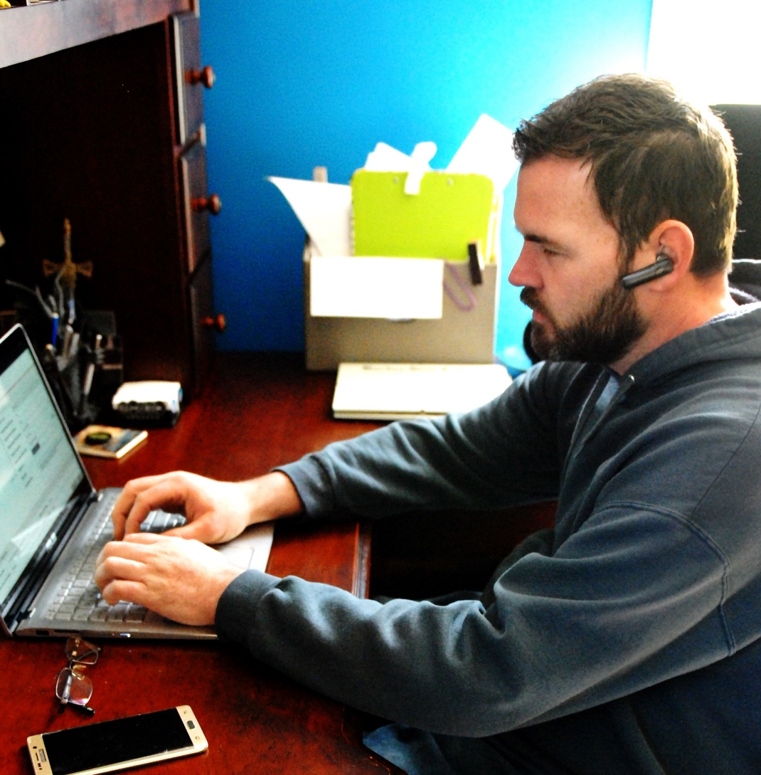
DAT Duty Officer (DDO)
Receives local disaster event notifications
Evaluates notification and determines Red Cross response
Is single point of contact for the on-scene DAT responders
Monitors safety of DAT members throughout a response
Monitors and supports DAT members:
Facilitates notifications and escalations to regional leadership
Uses RC Respond to manage and track ALL key aspects of the event-response
Notes:
INSTRUCTOR: please CLICK to reveal, one-by-one, the list of key activities that will be undertaken by the DDO:
Receives local disaster event notifications
Evaluates notification and determines Red Cross response
Recruits and dispatches DAT to event if appropriate
Is single point of contact for the on-scene DAT responders
Monitors safety of DAT members throughout a response
Monitors and supports DAT members:
Fulfills requests for additional support
During long incidents, bad weather, emotional stress etc.
Facilitates notifications and escalations to regional leadership
Uses RC Respond to manage and track ALL key aspects of the event-response

Slide 38
Tools and Systems
RC Respond
Red Cross event management system used to track resources assigned to DAT responses
Used by DDO at all stages of the response including recruiting and assigning DAT response team members and closing events when complete
Sign up for DDO shifts
RC Care
Red Cross Client management system
Used by DAT responders to open client cases, provide assistance and record event information and client immediate needs
Volunteer Connection and OneSource
Sources of useful reference information including relevant doctrine and training information (see DAT, RC Respond and RC Care Toolkits on The Exchange)
Your local stored* and printed copies of key documents
Backup reference information, in case of computer failure
* Use a local hard drive or USB stick
Notes:
INSTRUCTOR:
CLICK to reveal the list of key Tools and Systems of which the DDO should be aware and familiar:
RC Respond
Red Cross event management system used to track resources assigned to DAT responses
Used by DDO at all stages of the response including recruiting and assigning DAT response team members and closing events when complete
Sign up for DDO shifts
RC Care
Red Cross Client management system
Used by DAT responders to open client cases, provide assistance and record event information and client immediate needs
Volunteer Connection and OneSource
Sources of useful reference information including relevant doctrine and training information (see DAT, RC Respond and RC Care Toolkits on OneSource)
YOUR Local stored and printed copies of key documents
Backup reference information, in case of computer failure

Slide 39
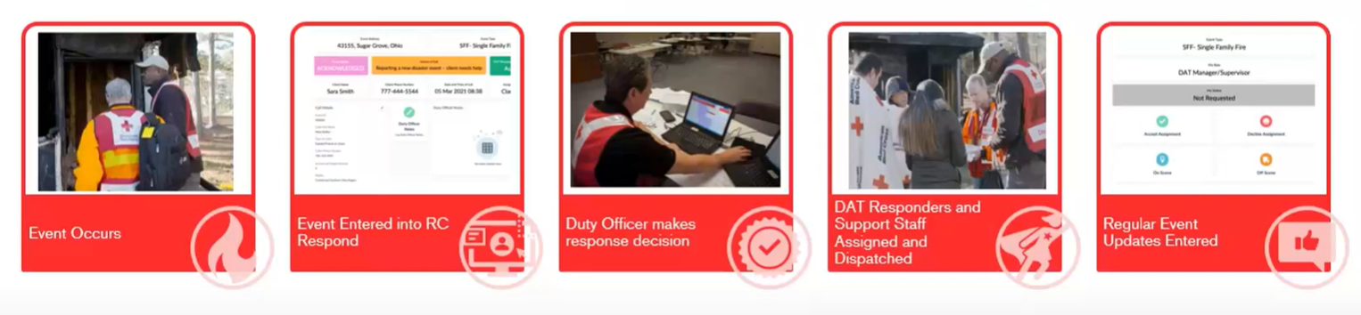
Event Notification Flow Overview
Event Occurs
Event Entered into RC Respond and Notified to DDO**
DDO makes response decision
DAT Responders and Support Staff Assigned and Dispatched
Regular Event Updates Entered in RC Respond
** Events are usually entered into RC Respond by Call Center
Activities undertaken by a Duty Officer
39
Notes:
INSTRUCTOR: Briefly summarize the Event Notification Flow:
Once an event has occurred and an agency or client calls the Red Cross for assistance, the event information will be entered into RC Respond. This is usually done by Red Cross National Dispatch, the organization which answers calls made to 1-800-RED-CROSS.
Note that a DDO only enters Events directly into RC Respond if they are not covered by National Dispatch (or other call center). How to do this is covered in the RC Respond Working as a Duty Officer training.
Once the event has been entered into RC Respond, the system will automatically send a message to the on-call DDO for the ZIP code in which the event occurred. This is how YOU will be alerted to an event in your territory.
As DDO:
You will evaluate the information provided and determine whether a Red Cross DAT response should be initiated
You will deploy a Disaster Action Team if appropriate and you will support them during the response
You will update RC Respond as appropriate and, when the response is completed, you will ensure that all responders have safely completed their response and left the scene

Slide 40


Key Response Activities of the DAT Duty Officer
DAT Duty Officer On Call
Ensure that all responders are safe; close event
Receive
Notification in RC Respond
Monitor
event
Confirm event and decide response
Activate
DAT in RC Respond
Support
DAT
Notes:
INSTRUCTOR: this slide has an automatic animation.
This graphic shows all the activities of a DAT Duty Officer from being on-call through managing an event response
We will go through these steps in more detail during this workshop.

Slide 41
Key Response Activities of the DAT Duty Officer
DAT Duty Officer On Call
Ensure that all responders are safe; close event
Receive
Notification in RC Respond
Monitor
event
Confirm event and decide response
Activate
DAT in RC Respond
Support
DAT
Notes:
First, we will discuss Receiving Notifications in RC Respond and will review different types of calls which may be received

Slide 42
The Disaster Notification
Typically, the Red Cross is notified of an event by a call to 1-800-RED-CROSS (National Dispatch) by one of the following external sources:
Fire Department
Police Department
Other local officials
A client or someone calling on behalf of the client
National Dispatch will create an event in RC Respond
RC Respond will then send an e-mail, text, and/or voice phone call* to the DDO on call
RC Respond alerts will come from a known number: you should confirm the most recent number with your supervisor and bookmark it.
*Note: in RC Respond, users can and should set their preferences for how to be notified
42
Notes:
Typically, the Red Cross is notified of an event by a call to 1-800-RED-CROSS (National Dispatch) by one of the following external sources:
Fire Department
Police Department
Other local officials
A client or someone calling on behalf of the client
National Dispatch will create an event in RC Respond
RC Respond will then send an e-mail, text, and/or voice phone call to the DDO on call
RC Respond alerts will come from a known number: you should confirm the most recent number with your supervisor and bookmark it.
It is essential that as the on-call DDO you can be reached quickly when an event is created. In RC Respond, you can and should set your preferences for how to be notified and you should choose a method which you are sure will alert you even if you are asleep. This is covered in RC Respond training which you are required to take to qualify as a DDO.
INSTRUCTOR: Advance to the next slide to show notifications

Slide 43
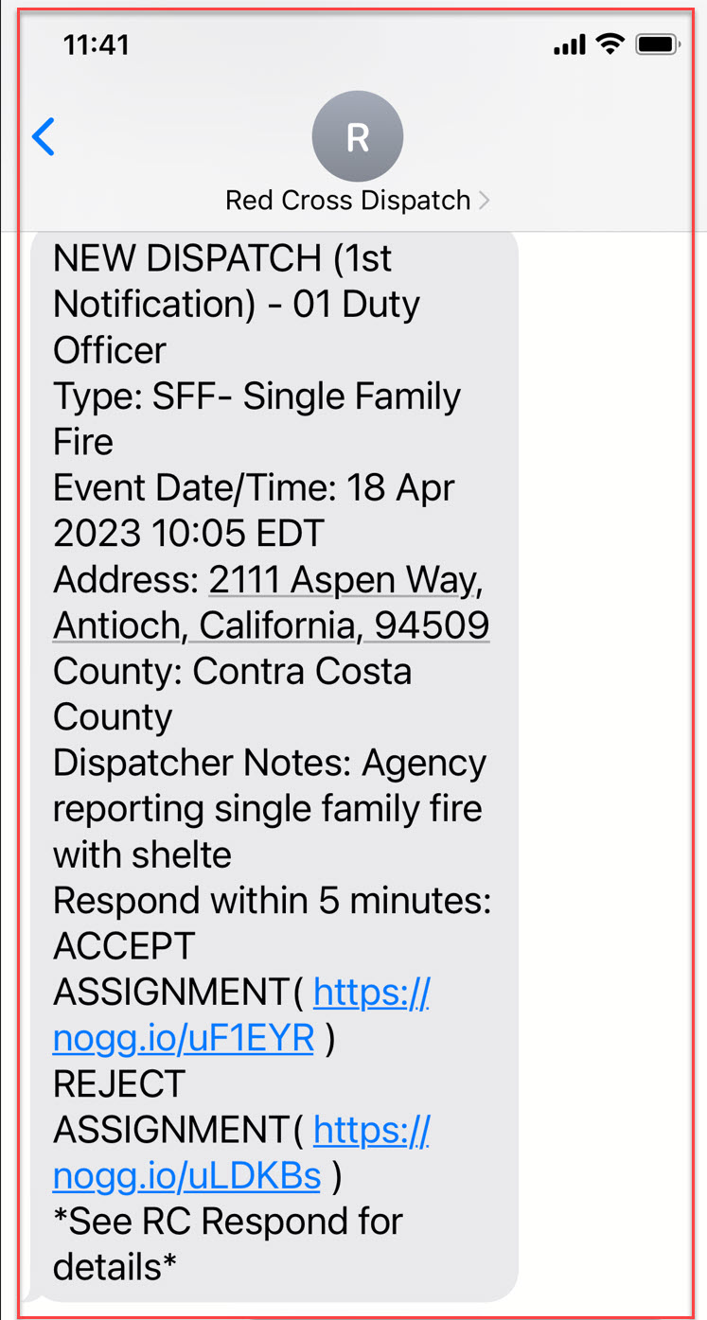
RC Respond SMS Event Notification
43
Notes:
Here is an example of the SMS notification you may receive.
There are very brief details of the event and there are options to permit you to accept or reject the assignment.
If you accept, your name will be immediately populated in the event record in RC Respond.
If you do not record your choice within FIVE minutes the system will try to reach you one more time and will then alert the next person on the RC Respond Duty Officer schedule DDO schedule, so it is very important that you respond promptly.
Once you have responded you should immediately review the event details in RC Respond.

Slide 44
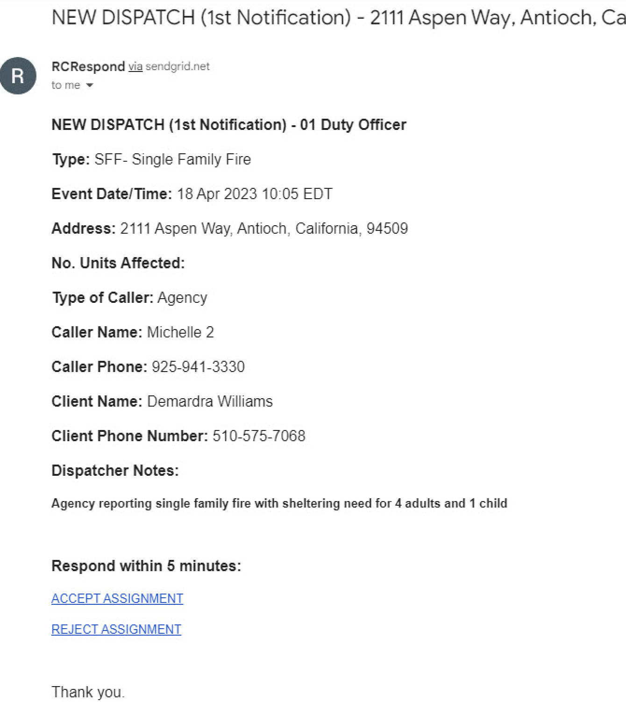
RC Respond Email Event Notification
44
Notes:
Here is an example of the Email notification you may receive.
As you can see, there are more details of the event than there are for the SMS. Again, there are options to permit you to accept or reject the assignment similar to the SMS example.

Slide 45
“Active Events” and “Past Events”
DAT Duty Officers (DDOs) may receive notification for two different categories of event:
An ACTIVE or on-going disaster
An event which took place in the PAST
May or may not have already been notified to the Red Cross
Each requires a different approach by the DDO prior to a decision to activate a Disaster Action Team response
Notes:
DAT Duty Officers (DDOs) may receive notification for two different categories of event:
An ACTIVE or on-going disaster
An event which took place in the PAST and which may or may not have already been notified to the Red Cross
CLICK
Each requires a different approach by the DDO prior to a decision to activate a Disaster Action Team response
INSTRUCTOR: you may wish to adapt the following slides if procedures in your Region/Territory differ but please make sure that any such adaptations are compliant with DAT Doctrine

Slide 46
Active Event
Notified to Red Cross while incident is still on-going
Usually notified by an Emergency Management Agency (EMA) official
Fire Department, Police or other local officials
Sometimes notified by community member
Can be verified immediately by EMA official (e.g.: local Fire Department)
OR
Cannot be verified immediately by EMA official
Notes:
An ACTIVE EVENT is one which is notified to the Red Cross when it is still on-going and likely an active scene.
Active events are usually notified by an Emergency Management Agency (EMA) official such as from a Fire Department, Police or other local official
Such events are sometimes notified by community members. If you receive such an event notification, you should attempt to verify with an appropriate EMA. Refer to your local procedures for appropriate ways to confirm such an event.

Slide 47
Past Event
Notification comes from a client or other individual for an incident that occurred in the past
May or may not have been notified to Red Cross before:
Events which National Dispatch identifies as being linked to past events usually notified directly to the recovery team:
E.g.: A client already served requests more information or help
DDOs will receive notifications for situations such as:
A new client calls us about an incident from the past and to which the Red Cross has not previously responded
Another client appears for an incident to which DAT has previously responded (was not present at the time of the response)
Notes:
A PAST EVENT is one for which Notification comes from a client or other individual for an incident that occurred in the past.
It may or may not have been notified to Red Cross before:
Events which National Dispatch identifies as being linked to past events are generally notified directly to the recovery team not the DDO:
E.g.: A client we’ve already served requests more information or help such as DHS/DMH assistance, referrals, additional funds, etc.
DDOs will receive notifications for situations such as:
A new client calls us about an incident from the past and to which the Red Cross has not previously responded
Another client appears for an incident to which DAT previously responded (was not present at the time of the response)

Slide 48
Active Event vs Past Event
For an active event which has EMA confirmation:
Top priority is to trigger appropriate response and recruit a DAT Supervisor or Manager plus at least one additional DAT responder and dispatch them to the scene as quickly as possible
For an event which does not have EMA confirmation:
Additional information required to confirm the disaster and determine the appropriate response. DDO may have to contact caller for more information and contact EMA to obtain confirmation
If the event occurred in the past, an immediate DAT response may not be required
If the event occurred more than 14 days prior to notification a DAT response is usually not required but referrals may be provided
Refer to Regional protocols for determining how to handle these situations
Notes:
CLICK
For an active event which has EMA confirmation the TOP priority is to trigger appropriate response and recruit a DAT Supervisor or Manager plus at least one additional DAT responder and dispatch them to the scene as quickly as possible.
The DAT Supervisor (or Manager) will be in charge of the response so, as a DDO, you should coordinate closely with them for all subsequent actions.
CLICK
For an event which does not have EMA confirmation:
Additional information required to confirm the disaster and determine the appropriate response. DDO may have to contact caller for more information and contact EMA to obtain confirmation
CLICK
For a Past event additional information may required to confirm the disaster, find out whether it was previously notified and determine the appropriate response. Note that, if the disaster occurred some time in the past, an immediate DAT response may not be required; DAT does not respond to events which occurred more than 14 days prior to notification but it is still important to provide feedback to the caller and to provide referrals to other resources if appropriate.
CLICK
Refer to Regional protocols for determining how to handle these situations

Slide 49
Responding to an Event: Overview
Receive event alert from RC Respond and acknowledge
Review details of event
Evaluate event information: determine if Red Cross action is required
Recruit a team based on responder availability using RC Respond.
Confirm incident information with requesting agency. Provide ETA of DAT on scene
Contact requesting agency or caller if insufficient information to decide
Monitor On-Scene arrivals of DAT members
Work with with on-scene DAT leadership during the response
Update incident details in RC Respond as appropriate
Ensure all DAT responders have safely left scene at end of response
Mark the event “Complete” in RC Respond
Notes:
This flow chart gives an overview of the various steps of the Response. CLICK TO REVEAL THE NEXT SLIDE and say: “we will now examine these in more detail”.
INSTRUCTOR: Some customization of this slide may be necessary if your Regional processes differ. Please ensure that any changes do follow the DAT Doctrine

Slide 50
Responding to an Event: Overview
Receive event alert from RC Respond and acknowledge
Review details of event
Evaluate event information: determine if Red Cross action is required
Recruit a team based on responder availability using RC Respond.
Confirm incident information with requesting agency. Provide ETA of DAT on scene
Contact requesting agency or caller if insufficient information to decide
Monitor On-Scene arrivals of DAT members
Work with with on-scene DAT leadership during the response
Update incident details in RC Respond as appropriate
Ensure all DAT responders have safely left scene at end of response
Mark the event “Complete” in RC Respond
Let’s review these steps in more detail

Slide 51
Receive event alert from RC Respond and acknowledge
Review details of event
Once you receive a notification of an event (SMS, Email, Voice Call) you must “accept” the assignment
Log into RC Respond to find the details and pertinent information for the event
Types of Requests
Agency will call in an active event
A client may “cold call” asking for assistance
Third party may call on behalf of the client
Notes:
As already mentioned, once you receive a notification of an event (SMS, Email, Voice Call) you must “accept” the assignment
Log into RC Respond to find the details and pertinent information for the event (how to do this is covered in the “RC Respond: Working as a Duty Officer” training course.
Types of Requests
Agency will call in an active event
A client may “cold call” asking for assistance
Third party may call on behalf of the client

Slide 52
Key Response Activities of the DAT Duty Officer
DAT Duty Officer On Call
Ensure that all responders are safe; close event
Receive
Notification in RC Respond
Monitor
event
Confirm event and decide response
Activate
DAT in RC Respond
Support
DAT
Notes:
Deciding the response to an event is a key responsibility of the DAT Duty Officer who receives an Event notification

Slide 53
Evaluate event information: determine if Red Cross action is required
Contact requesting agency or caller if insufficient information to decide
The DDO must decide:
Is a DAT response is required?
May require more information to make the decision
Should regional leadership be consulted?
Unusual events or requests which fall outside normal scope
Is immediate notification or escalation to regional leadership required due to the scope of the event?
If it exceeds DAT capacity to respond and provide service
or
If certain event-triggers occur
Notes:
Once notified of an event, the DDO should quickly determine whether a DAT response is required and evaluate how large a response is appropriate.
CLICK
You may need more information from the caller (agency or client) to make the decision
CLICK
You may need to consult regional leadership whether to respond especially for unusual events or requests which may fall outside normal scope of DAT responses
CLICK
You should evaluate if immediate notification or escalation to Regional Leadership is required due to the scope of the event if, for example, the incident exceeds DAT capacity to respond and provide service effectively or if certain event-triggers occur. We will discuss response and escalation decisions and event-triggers in detail later.

Slide 54
Making Decisions as a DDO
Depending on the type of incident for which Red Cross has been contacted, the DDO may have authority to decide:
No response is appropriate
A DAT should be activated
For other types of request, the DDO may have to escalate to Regional Leadership on Call (RLOC)for guidance
DDOs should have a copy of the Job Tool:
“Disaster Action Team / Regional Response Operational Profile and Decision-Making Authority”
Regional documentation may also be available
Notes:
Making Decisions as a DAT Duty Officer
CLICK
As mentioned, depending on the type of incident for which Red Cross has been contacted, the DDO may have authority to decide that no response is appropriate or that a DAT should be activated
CLICK
Or, you may have to escalate to Regional Leadership (RLoC) for guidance
CLICK
There is a Job Tool to help guide you in Decision Making
INSTRUCTOR: Provide to the attendees a copy of the Job Tool “Disaster Action Team / Regional Response Operational Profile and Decision-Making Authority”
INSTRUCTOR: Make adaptations to the slide to highlight any Regional specifics

Slide 55
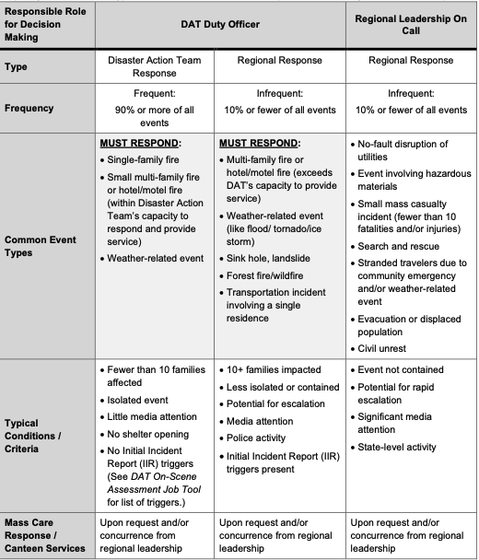
Decision Making Authorities
For events in the MUST RESPOND categories, the DAT Duty Officer:
Determines if the Red Cross will respond immediately
Activates a Disaster Action Team
For other regional events, the Regional Leadership On Call is responsible for determining if and when Red Cross will respond
Local disaster-caused events are generally authorized for Immediate (Financial) Assistance
Notes:
INSTRUCTOR: A copy of the “Disaster Action Team / Regional Response Operational Profile and Decision-Making Authority” job tool should be provided to each participant
CLICK
For events in the MUST RESPOND categories, the DAT Duty Officer:
Determines if the Red Cross will respond immediately
Activates a Disaster Action Team
CLICK
For other regional events, the Regional Leadership On Call is responsible for determining if and when Red Cross will respond
CLICK
Local disaster-caused events are generally authorized for Immediate (Financial) Assistance

Slide 56
Decision Making Authorities
There are many other events where Immediate Assistance is not authorized unless the event can be linked to disaster.
Other services may still be offered:
Referrals and problem-solving (Resource and Referral Case), to help clients develop the first steps in their recovery
Red Cross responses must be consistent with the Fundamental Principles of the Global Red Cross Network, particularly those of impartiality, neutrality and independence
Examples of events which may not warrant a response but for which Resource and Referrals might be appropriate:
Not sure? Escalate to RLOC
Community-wide power outages Frozen/burst pipes Car accidents Eviction | Bug infestations Broken furnace/heater/air conditioning Condemned house Utility shut off (not disaster-related) | Other maintenance-related issues, such as code enforcement or deferred maintenance by landlord Contaminated wells/water Lack of potable water
Notes:
CLICK
There are many other events where Immediate Assistance is not authorized unless the event can be linked to disaster.
Other services may still be offered such as Referrals and problem-solving (Resource and Referral Case), to help clients develop the first steps in their recovery
CLICK
REMEMBER that Red Cross responses must be consistent with the Fundamental Principles of the Global Red Cross Network, particularly those of impartiality, neutrality and independence
CLICK
Here are examples of of events which may not warrant a response but for for which Resource and Referrals might be appropriate
INSTRUCTOR: Please read the items in the table and illustrate based on your experience
CLICK
If you are in doubt or unsure do not hesitate to escalate to the Regional Leadership on Call for guidance

Slide 57
Evaluate event information: determine if Red Cross action is required
Contact requesting agency or caller if insufficient information to decide
WHEN IT IS DECIDED NOT TO RESPOND:
If an Agency called in the event:
Call back directly to the requesting agency and explain
If an individual called in the event:
Call back and explain courteously that the Red Cross is not able to respond and, if possible, provide alternative referrals
Notes:
Maintaining good relationships with our Agency partners is essential so if it is decided not to respond to an Agency request, you should call them and explain
CLICK
Treating any caller with respect and courtesy is also essential so individuals who contact Red Cross should also be called back and given an explanation for the Red Cross not responding and, if at all possible, should be given alternative referrals.
You should familiarize yourself with local resources which might be appropriate such as calling 211 or going to “resources.redcross.org

Slide 58
Evaluate event information: determine if Red Cross action is required
Contact requesting agency or caller if insufficient information to decide
WHEN THERE IS INSUFFICIENT INFORMATION?
If a client or someone on behalf of the client called:
Contact client/caller if necessary to gather more information for decision
For events which occurred > 14 days ago: no response unless authorized by RDO
If caller reports a fire, call local Fire Department non-emergency line to verify the event
Determine whether a Red Cross response is appropriate and if so:
Ask client if they have any form of ID and proof of residency at the affected address
Set realistic expectations with client
Activate the Response if the Client is waiting at the incident scene OR arrange a time and safe place for DAT to meet the client (consider recruiting a DAT Supervisor and consult them to arrange meeting)
Notes:
INSTRUCTOR: READ NOTES IN FULL TO SUPPLEMENT INFORMATION ON SLIDE
WHEN THERE IS INSUFFICIENT INFORMATION?
CLICK
If a client or someone on behalf of the client called:
Contact client/caller if necessary to gather more information and assess if the event and client may be eligible for assistance
Note: for events which occurred > 14 days ago: no response unless authorized by Regional Disaster Officer Exception
CLICK:
If caller reports a fire, you can call the local Fire Department non-emergency dispatch line to verify that event occurred and gather any additional details they can provide
CLICK:
Determine whether a Red Cross response is appropriate and if so:
Ask client if they have any form of ID and proof of residency at the affected address
Set realistic expectations with client (i.e., responders will assess eligibility when on scene, ETA for responders, etc.)
Activate the Response as for an Agency call if the Client is waiting at the incident scene OR arrange a time and safe place for DAT to meet the client (you may need to recruit a DAT Supervisor and consult them to arrange such a meeting)

Slide 59
Key Response Activities of the DAT Duty Officer
DAT Duty Officer On Call
Ensure that all responders are safe; close event
Receive
Notification in RC Respond
Monitor
event
Confirm event and decide response
Activate
DAT in RC Respond
Support
DAT

Slide 60
Recruit a team based on responder availability using RC Respond.
Confirm incident information with requesting agency. Provide ETA of DAT on scene
Monitor On-Scene arrivals of DAT members
Use the “DAT Activation” in RC Respond to identify scheduled responders
Contact the requesting agency with ETA for the Red Cross DAT
Ask agency if more details are available
Communicate additional information to DAT SV (phone, text or in RC Respond)
If RC Respond does not show a second DAT responder has accepted assignment, ensure that one additional DAT responder is dispatched (safety)
Follow Regional guidance on how to find additional responders
Use the “Add Regional Resources” feature in RC Respond to identify other responders who are on schedule within the region
Notes:
INSTRUCTOR: READ NOTES IN FULL TO SUPPLEMENT INFORMATION ON SLIDE
CLICK
For a response, use the “DAT Activation” function in RC Respond to identify all scheduled responders
CLICK
Identify the on-scene lead for the response (either DAT SV or DAT MN)
Exceptionally the lead may be virtual but there must be two qualified responders on-scene
CLICK
Contact the requesting agency with an ETA for the Red Cross DAT to be on-scene
Ask agency if more details are available
Communicate additional information to DAT SV
CLICK
If RC Respond does not indicate that a second DAT responder has accepted the assignment, ensure that one additional responder is dispatched (safety issue!!)
Follow Regional guidance on how to find additional responders
INSTRUCTOR: PLEASE ADD THE FOLLOWING:
You can use the “Observer” position in RC Respond to assign other Red Crossers to the response even if they are not rostered in RC Respond. There is a search function which will allow you to assign anyone who has a Volunteer Connection account and has a Disaster Cycle Services position. This will allow you to assign a second, non-DAT Red Crosser as a responder for SAFETY. You may also use this position to assign someone to go as an observer (such as an in-training DAT responder)
NOTE THAT, FOR SAFETY REASONS, EVERYONE WHO IS SENT TO A DAT SCENE MUST BE ASSIGNED AND TRACKED IN RC RESPOND.

Slide 61
Key Response Activities of the DAT Duty Officer
DAT Duty Officer On Call
Ensure that all responders are safe; close event
Receive
Notification in RC Respond
Monitor
event
Confirm event and decide response
Activate
DAT in RC Respond
Support
DAT

Slide 62
Work with with on-scene DAT leadership during the response
Update incident details in RC Respond as appropriate
At all times work closely with DAT SV (or DAT MN) leading the response
Notes:
During the time the DAT is on-scene and working with clients, you are a resource to assist the team and to permit them to focus on the clients.
At all times work closely with DAT SV (or DAT MN) leading the response
We will discuss this in more detail later in this course

Slide 63
Key Response Activities of the DAT Duty Officer
DAT Duty Officer On Call
Ensure that all responders are safe; close event
Receive
Notification in RC Respond
Monitor
event
Confirm event and decide response
Activate
DAT in RC Respond
Support
DAT

Slide 64
Ensure all DAT responders have safely left scene at end of response
Mark the Responders as “Complete” and close the event in RC Respond
DAT responders (“off scene” and are safely off the response (“complete”)
Responders “off scene” and “complete” in RC Respond
DDO may mark responders as “off scene” and “complete” in RC Respond after communication with them to verify
Phone call or SMS
Notes:
At the end of the response, DDO must be sure to verify that the DAT responders have left the scene and are safely off the response
Responders may self-report “off scene” using RC Respond when they leave the scene and may self-report “complete” when they are safely off the response.
DDO may mark responders as “off scene” and “complete” in RC Respond after communicating with them to verify that they are safely away from the scene and have completed their response. You can call them or send an SMS text message.
ALL RESPONDERS MUST BE ACCOUNTED FOR AT THE END OF THE RESPONSE.
Once all responders are marked complete, the DDO should Close the event in RC Respond.

Slide 65
BREAK TIME!!

Slide 66
Supporting the Disaster Action Team During a Response
Notes:
Let’s return to some of the ways in which you can support the DAT during a response

Slide 67
DAT Safety During a Response
Safety of the DAT responders
At least two on-scene responders Do not dispatch DAT members to a potentially dangerous location
You may need to identify a suitable meeting point
Suggest that the team talk and go to the scene of the event as a team
Work with the DAT Supervisor who is leading the response
Do not hesitate to local contact law enforcement if DAT needs protection
Notes:
We cannot over-emphasize SAFETY:
INSTRUCTOR CLICK to reveal each of the following points one-by-one:
Safety of the DAT responders is the top priority
At least two on-scene responders are REQUIRED for safety
Do not dispatch DAT members to a potentially dangerous location
You may need to work with the DAT/SV to arrange a suitable meeting point
Suggest that the team stage and go to the scene of the event as a team
Work with the DAT Supervisor who is leading the response
Do not hesitate to contact local law enforcement if DAT needs protection

Slide 68
Supporting the DAT
The DAT Supervisor (or Manager) manages the response and the event scene
Additional resources may be requested by responders to support their work and to provide service to clients
DDO should support any additional resource requests so that the responding team can focus on providing assistance to the clients and them
In growing or large events, the DDO will also assist the on-scene team by managing escalation protocols
We will review some of the more common additional resource requests that a DDO may receive
Notes:
INSTRUCTOR CLICK to reveal each of the following points one-by-one:
The DAT Supervisor (or Manager) manages the response and the event scene
Additional resources may be requested by responders to support their work and to provide service to clients
DDO should support any additional resource requests so that the responding team can focus on providing assistance to the clients and them
In growing or large events, the DDO will also assist the on-scene team by managing escalation protocols
We will review some of the more common additional resource requests that a DDO may receive

Slide 69
Supporting the DAT:
Additional Resources
DHS (disaster health services) if any injury, fatality, lost meds, etc.
DMH (disaster mental health) if clients or responders request or need immediate emotional support
DSC (disaster spiritual care) if clients requests or need spiritual / emotional support
PA (public affairs) if media present or for a large incident
NOTE:
Follow Regional protocols for notifications
Do NOT document any confidential information in RC Respond
Notes:
INSTRUCTOR: UPDATE THE HIGHLIGHTED SECTION TO REFLECT YOUR REGIONAL PROTOCOL
INSTRUCTOR Mention each of the following points:
DHS (disaster health services) if any injury, fatality, lost meds, etc.
DMH (disaster mental health) if clients or responders request or need immediate emotional support
DSC (disaster spiritual care) if clients requests or need spiritual / emotional support
PA (public affairs) if media present or for a large incident
NOTE:
Follow Regional protocols for notifications
Do NOT document any confidential information in RC Respond

Slide 70
Supporting the DAT:
Examples Additional Resources
Accommodation: DDOs can assist in finding hotels with availability and make reservations for clients, if needed.
Where to look for hotels?
Hotel websites & apps (hotels.com, booking.com, Expedia, bringfido.com etc.)
Google Maps search for “hotel” near incident
Check for specific client considerations:
Accessible rooms, pets, refrigerators for medicine/food, free breakfasts, etc.
Send this information to the DAT responder(s) on-scene
It is best to get the clients to make their own reservation (hotels often want credit card information etc.)
Notes:
INSTRUCTOR: CUSTOMIZE THIS SLIDE TO REFLECT YOUR REGION’S PROCESSES
A key goal of our DAT response is to ensure the displaced clients have a safe place to go and stay overnight. If they do not have resources such as family or friends locally, they may need help to locate and secure hotel accommodation for the night. If this is the case, as DDO you can help the on-scene team by finding suitable hotels with availability near the incident.
CLICK
Here are some examples of where you can look for hotels using websites and Apps. A few quick phone calls may identify some possibilities; to save time you might start this while the team is on the way to the scene since it is quite a common request.
CLICK
Don’t forget specific client considerations such as: accessible rooms, pets, refrigerators for medicine/food, free breakfasts, etc.
CLICK
You can send the information to the on-scene team by Text. Most hotels will not take a reservation without a credit card number, so it is best to have the clients make their own reservations. The on-scene team can help with this.

Slide 71
Supporting the DAT:
Examples of Additional Resources
Translation Needs
People on scene (family members, neighbors, first responders etc.)
Bilingual DAT responders or other ARC volunteers on scene or by phone
Smart phone (e.g.: Google Translate)
Translation service (Language Line) if available in your region
Client Transportation (note: Red Cross cannot transport clients)
Client drives self or gets ride from family member/neighbor/friend
Taxi (Region/Territory may have an agreement with a taxi firm)
Pets
Can they stay in yard where incident was or can a family member, friend, or neighbor take them?
Find pet-friendly hotel (www.bringfido.com)
Other local resources may be available
Notes:
INSTRUCTOR: CUSTOMIZE THIS SLIDE TO REFLECT YOUR REGION’S PROCESSES
Here are some additional examples of support with which you may be able to help:
CLICK
Translation Needs
People on scene (family members, neighbors, first responders etc.)
Bilingual DAT responders or other ARC volunteers on scene or by phone
Smart phone (e.g.: Google Translate)
Translation service (Language Line) if available in your region
CLICK
Client Transportation (note: Red Cross cannot transport clients)
Client drives self or gets ride from family member/neighbor/friend
Taxi (Region/Territory may have an agreement with a taxi firm)
CLICK
Pets
Can they stay in yard where incident was or can a family member, friend, or neighbor take them?
Find pet-friendly hotel
Other local resources may be available

Slide 72
Supporting the DAT:
Other Additional Resources
Food & Drinks (at scene of incident)
Check local practices:
DAT Supervisor may have DAT purchase card
DAT responder may be able to run to grocery store to pick up supplies
If ordering food, be cautious of dietary preferences/restrictions
Emergency Response Vehicle (ERV) or another local Red Cross vehicle
Equipped with snacks and water
Dry place for the DAT to work; makes Red Cross role visible
Some DAT team members can drive ERV; may need to request driver from local ERV team (see local procedures)
Notes:
INSTRUCTOR: CUSTOMIZE THIS SLIDE TO REFLECT YOUR REGION’S PROCESSES
CLICK
Food & Drinks (at scene of incident)
Check local practices:
DAT Supervisor may have DAT purchase card
DAT responder may be able to run to grocery store to pick up supplies
If ordering food, be cautious of dietary preferences/restrictions and ensure food purchased is in alignment with region's mass care/feeding protocols.
CLICK
Emergency Response Vehicle (ERV) or another local Red Cross vehicle
Equipped with snacks and water
Dry place for the DAT to work; makes Red Cross role visible
Some DAT team members can drive ERV; may need to request driver from local ERV team (see local procedures)

Slide 73
Escalation and Initial Incident Reporting

Slide 74
Escalation and Initial Incident Reporting
Escalation required for increased complexity or scope of an incident (often indicated when a “Trigger” is met):
DAT SV should notify DDO to escalate to Regional Leadership in a timely manner
DAT should also inform Public Affairs for certain Triggers to coordinate public messaging
If Triggers are met, regions are required to submit an Initial Incident Report (IIR) within two hours using the tool in RC Respond
Regions may have their own Escalation and IIR protocols and Triggers so verify with your leadership
74
Notes:
INSTRUCTOR: Please read the following in full:
Escalation is required if the complexity and/or scope of an incident exceeds normal parameters of a DAT response (often indicated when a “Trigger” is met); we will discuss typical triggers shortly.
It is important that the DAT SV notifies DDO to escalate to Regional Leadership in a timely manner in order to ensure the Region’s ability to respond quickly and provide support as needed
DAT should also inform Public Affairs for certain Triggers in order to coordinate public messaging
If certain Triggers are met, regions are required to submit an Initial Incident Report (IIR) to National leadership within two hours using the IIR tool in RC Respond
Regions may have their own Escalation and IIR protocols and Triggers so verify with your leadership

Slide 75
Initial Incident Reporting Triggers (1)
A disaster-related death has occurred (including residential fires)
Multiple significant injuries have occurred as a result of a disaster
A Red Cross volunteer or employee has been killed, injured, or is unaccounted for during a Red Cross event or activity
A Red Cross facility has been damaged as a result of a disaster
Any shelter has, or will be, opened or put on standby
75
Notes:
Triggers which require an Initial Incident Report to be created are defined in the Disaster Cycle Services Concept of Operations.
This slide and the next slide list these triggers.
In all cases a DDO should alert Regional Leadership on Call as soon as there is an indication that one or more of these triggers might be met.
The triggers are:
A disaster-related death has occurred (including residential fires).
Multiple significant injuries have occurred as a result of a disaster.
A Red Cross volunteer or employee has been killed, injured, or is unaccounted for during a Red Cross event or activity.
A Red Cross facility has been damaged as a result of a disaster.
A significant evacuation has occurred in a community.
Any shelter has, or will be, opened or put on standby.
ADVANCE TO THE NEXT SLIDE

Slide 76
Initial Incident Reporting Triggers (2)
The disaster-related incident has significant media coverage.
The estimated cost of a disaster-related incident is expected to exceed $10,000.
Inter-regional Red Cross mutual aid (human and/or material resources from outside of the affected region) has been requested or is expected to occur.
A state, local, tribal, or territorial Emergency Operations Center and/or FEMA Regional Response Coordination Center has been activated and the Red Cross is providing coverage
76
Notes:
The disaster-related incident has significant media coverage
The estimated cost of a disaster-related incident is expected to exceed $10,000.
Inter-regional Red Cross mutual aid (human and/or material resources from outside of the affected region) has been requested or is expected to occur.
A state, local, tribal, or territorial Emergency Operations Center and/or FEMA Regional Response Coordination Center has been activated and the Red Cross is providing coverage.
ADVANCE TO THE NEXT SLIDE

Slide 77
When Events Reach a Trigger
Notify Regional Leadership on-call (RLOC) as soon as you or the DAT SV thinks you might hit an Escalation Trigger
Sooner is better than later
Notify the Territory Disaster Program Manager
Follow any other local requirements
Notes:
INSTRUCTOR: CUSTOMIZE THIS HIGHLIGHTED PART OF THE SLIDE TO REFLECT YOUR REGION’S PROCESSES
Notify Regional Leadership on-call (RLOC) as soon as you or the DAT SV thinks you might hit an Escalation Trigger
Sooner is better than later
It is a good practice to notify the Territory Disaster Program Manager
Follow any other local requirements

Slide 78
Once Event has been Escalated
Working with the Regional Leadership on-call (RLOC)
Typically, the RLOC will handle other notifications, initiate sheltering, etc. so DDO can focus on supporting the on-scene DAT
Tasks may be shared between RLOC & DDO at RLOC’s discretion
Communicate often
Be clear regarding in which roles responders are functioning
Respect Chain of Command and Unity of Command
Responsibilities if a shelter opens
DDO & DAT SV (MN) own the DAT scene
RLOC or Mass Care Lead owns the shelter activity and scene
Be careful about responders drifting back and forth; ensure clear transfer of responders so they understand Chain of Command
Notes:
Working with the Regional Leadership on-call (RLOC)
Typically, the RLOC will handle other notifications, initiate sheltering, etc. so DDO can focus on supporting the on-scene team
Tasks may be shared between RLOC & DDO at RLOC’s discretion
Communicate often
Be clear regarding in which roles responders are functioning and what is their chain of command (they cannot be at DAT scene and responsible for, say, opening a shelter at the same time)
Respect Chain of Command and Unity of Command
Unity of command means that each responder only has ONE boss at any given time and they know who it is.
If a shelter opens
DDO & DAT SV (MN) own the DAT scene
RLOC or Mass Care Lead owns the shelter activity and scene
Be careful about responders drifting back and forth; ensure clear transfer of responders so they understand Chain of Command.
If DAT responders stay at the incident scene they should continue to report to the DAT/SV or MN who is in charge of the scene, If DAT responders leave the incident scene to help with another activity such as opening a shelter, then their chain of command must change, and they should now report to whoever owns the new activity.

Slide 79
Documenting Event Information in RC Respond (Confidentiality)
RC Respond provides a field for “Duty Officer Notes” in each event record
This may be used to document items such as:
status changes
reasons for not responding
information which may be needed by another DDO who takes over the call
A new DDO note should be created with each update to preserve a chronology for the event
DDO notes should NOT be used to record any personal or confidential information about clients
Notes:
Client must feel confident that the Red Cross will keep Confidential any information about them
Do not enter any confidential client information in RC Respond
CLICK
RC Respond provides a field for “Duty Officer Notes” in each event record
CLICK
This may be used to document items such as:
status changes
reasons for not responding
information which may be needed by another DDO who takes over the call
CLICK
A new DDO note should be created with each update to preserve a chronology for the event.
CLICK
DDO notes should NOT be used to record any personal or confidential information about clients

Slide 80
Separation of Roles

Slide 81
Separation of Roles
DDOs may not:
Create cases and/or activate Client Assistance Cards for DATs in the RC Care Intake for any clients
Confirm ID and Address
DAT responders must do these confirmations themselves.
DDOs who are also DAT responders must not serve in both roles for the same event even if they do so at different times
Notes:
INSTRUCTOR: Provide participants with a copy of the “Disaster Action Team Program Procedures - RC Care, RC Respond, and Client Care Program” Job Tool
There are some important rules regarding separation of roles. These rules are in place to guard against fraud.
For DAT Duty Officers these are:
DDOs may not:
CLICK
Create cases and/or activate Client Assistance Cards for DATs in the RC Care Intake for any clients
CLICK
Confirm ID and Address
DAT responders must do these confirmations themselves.
CLICK
DDOs who are also DAT responders must not serve in both roles for the same event even if they do so at different times

Slide 82
Regional Content

Slide 83
Next Steps
Complete all DDO Training:
Disaster Action Team Response Fundamentals
Not required if DAT Fundamentals already completed
Disaster Action Team Duty Officer Fundamentals (this training)
RC Respond Basics
RC Respond: Working as a Duty Officer
Handling a crisis call
Be sure you are aware of Regional or Chapter/Territory specifics
Get involved!
Notes:
Complete all DDO Training:
Disaster Action Team Response Fundamentals
Not required if DAT Fundamentals already completed
Disaster Action Team Duty Officer Fundamentals (this training)
RC Respond Basics
RC Respond: Working as a Duty Officer
Handling a crisis call
Be sure you are aware of Regional or Chapter/Territory specifics
Get involved!

Slide 84
Little Rock Duty Officers
Shifts are 6 hours
Shift frequency: 4 shifts a day
Chain of command: For support while on shift, DAT Duty Officers should reach out to RLOC
Notes:
INSTRUCTOR: For you to customize

Slide 85
Next: RC Respond Basics RC Respond: Working as a Duty Officer Handling a crisis call
Notes:
Thank you so much for your interest in helping carry out our daily mission of responding to home fires.
OPEN UP for QUESTIONS

Slide 86
Handling a crisis call

Slide 87
Harm to themselves Harm to others Medical emergencies

Slide 88
How do you know if someone is in distress?
Ask them!

