Slide 1
Disaster Volunteer Reception Center (VRC) Simulation
Jamie Lane, Disaster Program Manager
November 14, 2025
Notes:
Put acronyms flip chart on the wall and add as needed
Put "community garden" flip chart on the wall to plant ideas until we can get back to them

Slide 2
Agenda
Welcome & Introductions
Review VRC fundamentals
Scenario A
Lunch
Scenario B
Scenario C if time
Debrief and Closing

Slide 3
Introductions
Name
Organization, Role in a Disaster
One thing you hope to learn today

Slide 4
Objectives
Practice your plan
Understand any gaps where your plan can be
improved to better utilize spontaneous volunteers to
meet community needs safe and effectively.

Slide 5
Spontaneous Volunteer vs Affiliated Volunteer
Notes:
Disaster Volunteering is necessary for the recovery and healing of people and communities
Religious/Faith-based motivation
Sincere desire to help
Share their experiences as disaster survivors
Personal benefits
Court-ordered community service
Because they are asked!
Some volunteer with groups, we call these affiliated volunteers. Others just show up because of the reasons we mentioned- we refer to these as spontaneous or unaffiliated volunteers

Slide 6
Characteristics of Spontaneous Volunteers
Timely help
Not attached to any organization
Wide range of skills
May have disaster training
Individuals or groups
May be local or out-of-town/State
May be disaster survivors
Notes:
Review any they missed and ask for other characteristics.
Facilitation note: If we have all these unknowns, then why would we ever want to put them into a disaster response effort? Why engage with spontaneous volunteers?
Don’t process this question, let them respond and advance to the next slide

Slide 7
Why is Disaster Volunteer Coordination Needed?
Notes:
Why else is disaster volunteer coordination needed?
No matter how prepared a community is for a disaster event, there is still chaos.
First Responders and Emergency Management need to focus on safety, security, and establishing command to leverage the right resources at the right time.
If there isn’t a plan to manage the “flood” of people that show up to help, you only add to the chaos and hinder the progress.
The value of volunteer time can make a positive impact.
Safety of volunteers and homeowners
Efficient use of resources
Some volunteer with groups, we call these affiliated volunteers. Others just show up because of the reasons we mentioned- we refer to these as spontaneous or unaffiliated volunteers

Slide 8
How can my community be preprepared to manage volunteers?
Establish a plan and practice annually
Work with state, county, and local partners in advance
Assign positions, especially leadership, before the event
Ensure Emergency Manager knows the plan and “approves” leadership
Take your time to work through the big issues
Notes:
This is what we’ll be doing today- building off plans already in place and starting ongoing conversations to plan for the future.
Your communities have detailed plans in place- we’re going to talk about how you get them off the shelf and into action- starting with discussing how to create a Volunteer Reception Center.

Slide 9
Components of a Volunteer Reception Center (VRC)
Registration
Screening
Assignment
Credentialing/ID
Safety/Training & Gathering Supplies and PPE (Personal Protective Equipment)
Transportation (possibly)
Check In & Check Out
Notes:
A VRC is very similar to hosting a day of service event, including the basic components of effective volunteer engagement.

Slide 10
Step #1 Registration
The receptionist will greet people. Determine the purpose of their visit and direct them accordingly.
Give Volunteer Instructions
Have volunteer complete a Volunteer Registration/Release Form
Thank volunteers
Make sure that they explain the process, so they best understand that they need to be patient
Notes:
Survivors and those with in-kind donations may also visit the VRC
Explaining is very important- if people know why they need to go through the process (tracking hours for match), much more likely to stick with the process
Ex: LCOH in Greenfield

Slide 11
Step #2 Interview
Each incoming volunteer will be seen by an Interviewer who will review the Volunteer Registration Form for completeness
The interviewer must conduct a brief interview with a potential volunteer to find an appropriate placement, based on the volunteers’ abilities and interests
Use interview questions as a guideline to complete the interview
Watch for Red Flags. Make recommendation.
Pass information to “Matcher” for final placement
Notes:
Before you begin, thank the volunteer for coming out to assist today.
Potential Red Flags – they are a victim of the disaster, tired/exhausted, pushy, just want to “destroy” things, etc.
Make sure to have this flow quickly to avoid lines and long waits
Complete the Volunteer Referral Form
If you are a “team leader” for a group you came with, such as coach of high school football team, a corporate company team volunteering for the day, etc. – then they can go through the process for the team possibly, to avoid long lines, big group of people standing around, etc.
You want to make sure there is a calm environment and that people are “organized” and not wondering around. This will keep things running smoothly and a safe environment – need a security/doorman too.

Slide 12
Step #3 Assignment
Based upon the interview, the matcher will attempt to match a volunteer with an appropriate opportunity
If possible, they will make the match on the spot. Volunteers may have to wait a while until you have found a match for them. They may also be released for the day and contacted when a job for them has opened.
When matched the volunteer will be sent to Credentialing
Notes:
This could be a continuation of the Interview station
Someone is the “leader” of this station who has a list of work orders/jobs that need to be accomplished
This list of work orders are coming from the “Phone Bank” and “Data Coordination” stations
Hand out credentials if needed…or at next station (wristbands, IDs, etc.)
Send to Safety Briefing
You may also have people wait until you have a small group/team of people to send out for a project/task

Slide 13
Step #4 Safety Training
Thank volunteers
Conduct the orientation and safety briefing
Each volunteer will receive and identification badge, wrist band or lanyard that will allow volunteers to enter restricted areas
Volunteers are required to return to the Exit Station at the end of the day to check in
Hand in forms, wrist band, and volunteer hours sheet
Gather any tools, PPE equipment needed (snacks, water, etc)
Sent to the debriefing
Notes:
what to expect on the site
the equipment they may need for the assignment
all safety information and training they need before leaving the VRC to head to their site
Coordinate with transportation to make sure they have enough room on bus/van to drive the team to their site with equipment, or give directions if they are walking
If needed, train the volunteers in specific trainings, removing dry wall techniques, operating machinery, etc.
The liability form may be completed at registration, but they might “turn it in” to you at this point as a way to say they are ready to “exit” the VRC (safety feature)
Learn about local hazards, such as weather, from EOC briefing. Be sure to provide instructions about what to do.

Slide 14
Step #5 Credentialing
Provides identification to keep impacted areas secure
Confirms volunteer has participated in check-in process
Can be used to track when volunteers arrive and leave
Can be completed using badges, wrist bands, or lanyards
When credentialed the volunteer will be sent to the Safety Briefing station
Notes:
May be helpful to complete in advance for large groups
Can be creative where to get materials in a pinch

Slide 15
Step #6 Transportation/Mapping
Varies by event
Self-transport to volunteer site
Bussing to volunteer site
Provide instructions for how to reach VRC if anything comes up
Driving directions or directions for requesting pick up
Instructions for returning to VRC to sign out
Notes:
Chad
Slip of paper with VRC phone number, or have them take a picture of a posted number on the way out

Slide 16
Step #7 Debriefing/Specific Job Training
Sign volunteers out to capture hours, work performed, and equipment used
Ensure everyone has returned safely
Educate about signs and symptoms of stress and coping strategies
Provide individual and group defusing and debriefing
Assess workers’ functioning regularly
Notes:
This is something all leads at the VRC need to be aware of and allow people breaks

Slide 17
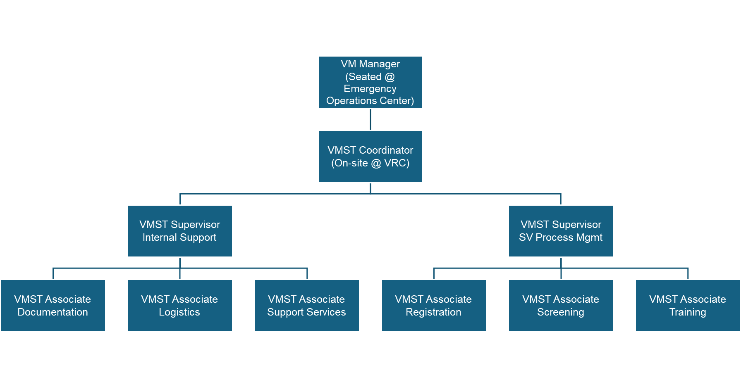
VRC Staffing
Notes:
(Taken from Scott County EMA Plan)
1. VMST Manager
Coordinate all volunteer support operations, supervision, scheduling, and assignment of Volunteer Management Coordinators (VMC). Facilitate staff meetings, responsible for receiving reports from Coordinators daily. Interface with all other Emergency Support Functions (ESF) in the Emergency Operations Center.
2. VMST Coordinator
Mandatory – Serves as the VRC site manager. Oversees operations of the Registration Center including scheduling of VRC staff; set-up for comfort of the staff and efficient response to volunteers; briefs, assigns tasks, and supervises key VRC staff (Appendix 4); monitors the operation; makes changes when necessary and coordinates with the VMST Manager regarding changing requirements. Administer the EMA Oath, sends forms with signature to EMA office.
3. VMST Supervisors
These positions are to be utilized when the VRC is fully staffed. Each Supervisor is responsible for a segment of the VRC operations including supervision of Associate level staff, coordination with the VMST Coordinator and other duties as assigned. Coordinates receiving agency requests with VMST Manager, collects pertinent information from VMST Manager about needed volunteer assistance; briefs VRC staff regularly on requests.
VMST Supervisor, Internal Support
This position directly supervises the VMST Associate in documentation, logistics and support services.
VMST Supervisor, Process Management
This position directly supervises the VMST Associate in registration, screening and training.
3. VMST Associates
These six (6) positions are to be utilized when the VRC is fully staffed. Each Associate is responsible for an activity in the VRC operations. Associate staff may supervise spontaneous volunteers recruited to complete the process or may be responsible for the process themselves.
VMST Associate, Documentation (under Internal Support)
Collects, organizes and shares information regarding volunteer opportunities and referrals; prepares reports; responsible for ensuring that the VRC Personnel Sign-in/out register is maintained. Provide identification for volunteers after receiving completed paperwork.
VMST Associate, Logistics (under Internal Support)
Provides technical assistance (when technology is available); provides necessary supplies; provides for feeding and rehab of VRC staff; identifies additional tools that will provide efficiencies in the job.
VMST Associate, Support Services (under Internal Support)
Responsible for the data entry, phone bank, runner staff within the VRC.
VMST Associate, Registration (under Process Management)
Ensures that each visitor is greeted and their needs are identified and met; distribute and assist with completion of Volunteer Registration form; ensures traffic flow (ingress/egress) at entry of facility.
VMST Associate, Screening (under Process Management)
Ensures each candidate is screened for placement; verify professional qualifications (credentialing); make referral to appropriate agencies based on need. Background check through Sheriff’s dept.
VMST Associate, Training (under Process Management)
Provides a general safety briefing to every volunteer that is referred to a receiving agency. Provides general safety/health coordination including basic first aid at the VRC. Provides additional job training as available based on community needs.

Slide 18
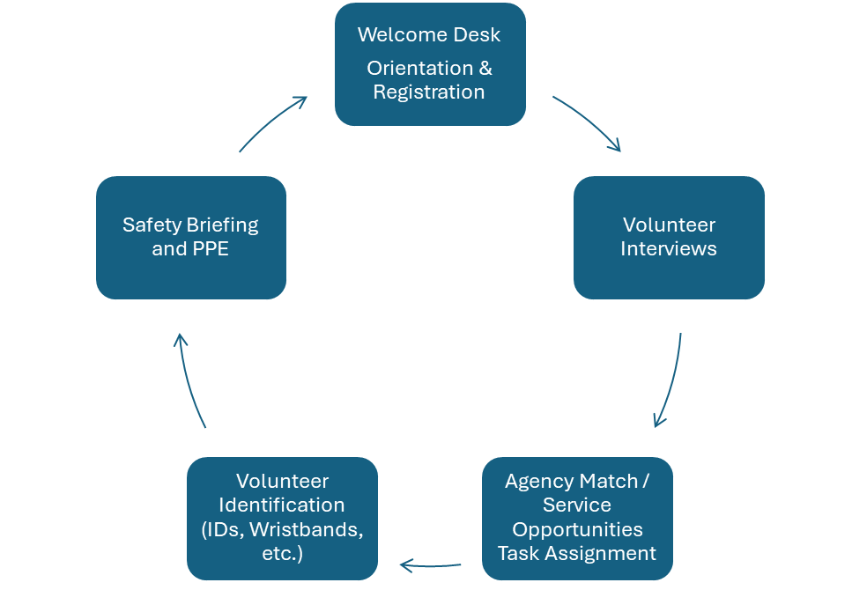
Volunteer enters
Screening
Volunteer exits to transportation

Slide 19
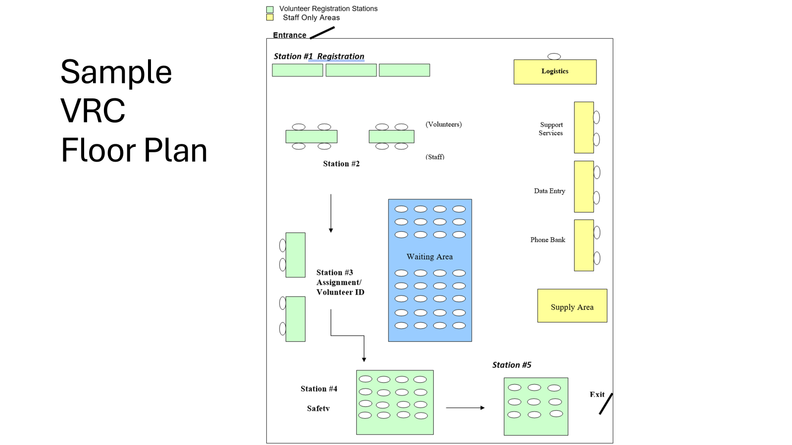
PPE
Identification
Safety Briefing

Slide 20
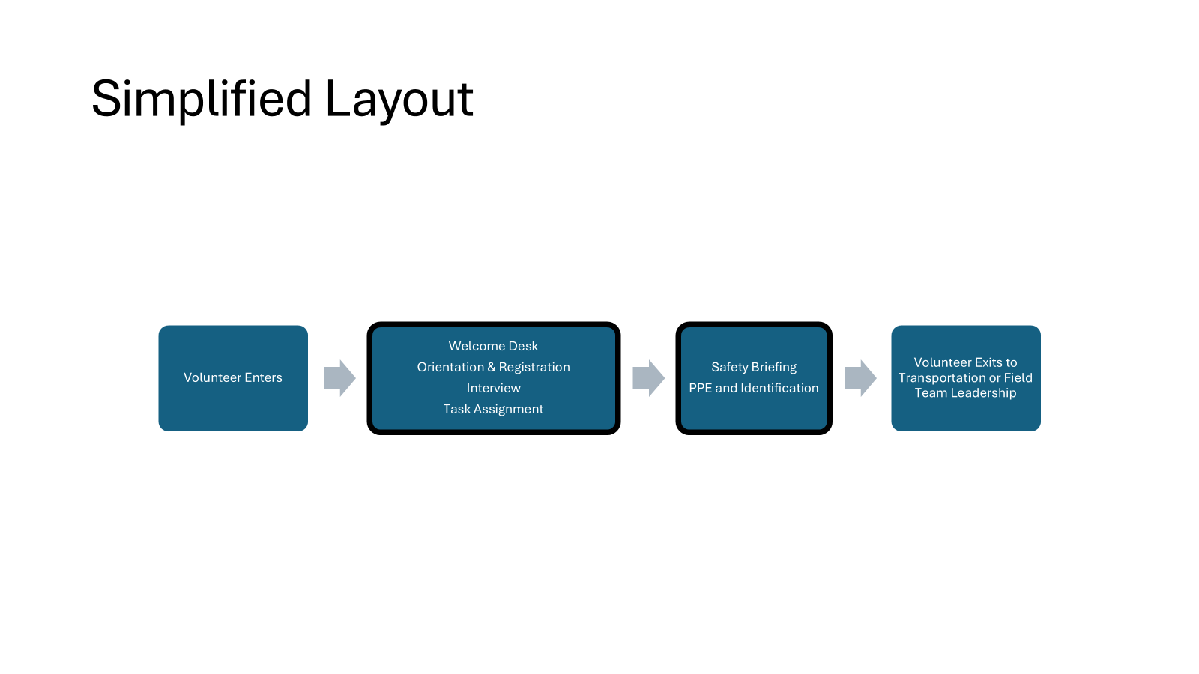
Simplified Layout

Slide 21
Video Joplin VRC

Slide 22
TRACKING VOLUNTEER HOURS
Volunteer hours must be documented in an auditable way for hours to count towards the FEMA cost-share.
Volunteer’s Name -first and last
Location of Volunteer Work –the specific address of the service site
Hours Worked –a sign-in time and a sign-out time
Type of Work –a brief description, i.e.:
Donations Management for loading, unloading and sorting donations
Shelter Management for assisting shelter residents or staff
Mass Feeding for cooking or serving food to shelter residents or volunteers
Debris Removal for clearing debris, cleaning up yards, and clearing streets.
Equipment used- some types of equipment, such as chainsaws or generators, also have reimbursable dollar amounts attached
Notes:
If you remember one thing out of this training, I hope it’s knowing the importance of tracking hours and what you need to track to count it as match

Slide 23
Data Entry & Coordination
Salamander
Rapid Tag
Tracking
Have a back up
Responsible for keeping a daily tab of the number of volunteers & hours for daily reports.
Collects name, location, activity, and check in check out times for FEMA reporting.
Notes:
Other roles can include Data Coordination- tracking and entering volunteer data to get daily totals of volunteers and hours, and ensuring data is accurate and complete

Slide 24

Phonebank Internal VRC Number
The phone bank handles phone calls from individuals and/or organizations requesting volunteers
People or groups who want to volunteer.
Also utilized for volunteers whom get lost, need transportation, or if allowed to check out.
Other
Notes:
Other roles can include Data Coordination- tracking and entering volunteer data to get daily totals of volunteers and hours, and ensuring data is accurate and complete

Slide 25
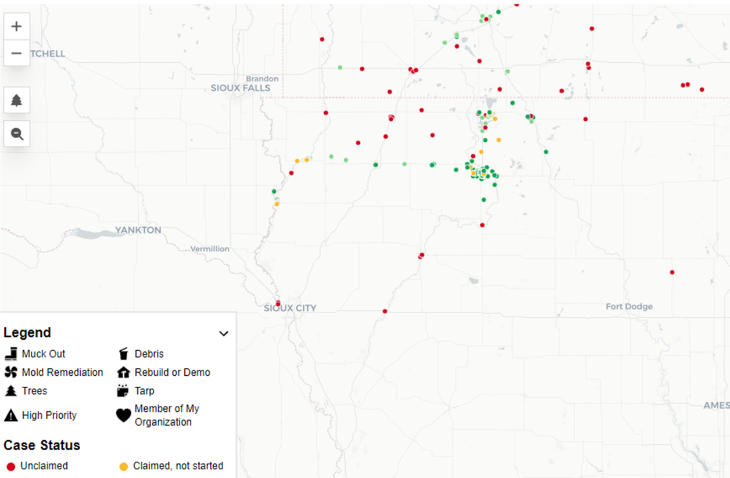
Following up with needs, and work completed?
Crisis Cleanup
Database for disaster related property needs
Affected residents could call hotline to report needs
Affiliated organizations can enter, view, claim, and manage work orders
Disaster volunteer coordinators can assign groups of volunteers
Information can be shared with Long Term Recovery Groups, Emergency Management, and others, as necessary

Slide 26
VOAD Partners and State Resources
Voluntary Organizations Active in Disaster (VOADs)
Homeland Security and Emergency Management
Iowa Disaster Human Resource Council (IDHRC)
Volunteer Iowa
Notes:
Examples of different groups and what they do
IDHRC
Crisis Clean Up
Go Serve Global
Team Rubicon
Southern Baptist
Samaritan’s Purse
Christ in Action
All Hands
NECHAMA

Slide 27
Decision Points Planning for your community
Notes:
Decision Points
Local assets and ideas
Who will run the VRC?
Activation Process
Location (In-person full/partial, virtual, multi-site, hybrid)
Credentialing/Tracking (Salamander, wristbands, background checks, Excel)
Supplies (Food, water, PPE, Equipment)
Places to send volunteers (EOC identified needs, local nonprofits, VOAD, VRC team leads)
In the field supervision (VOADs, local groups)
Work Order Collection (EMA, Phone bank, Iowa Concern Hotline, 211, Crisis Cleanup)
Workorder management (Crisis Cleanup, Excel)
Media/Outreach (PIO, Get Connected)
Demobilization (Data, Unmet Needs, Equipment/Supplies)

Slide 28
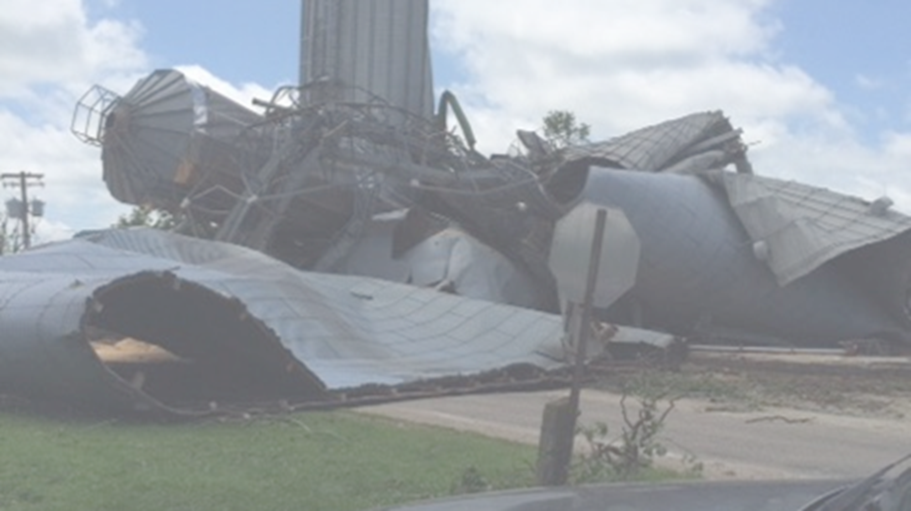
Simulation
Notes:
Tornado through town
Ask EMAs to share what they are doing in first 12-24 hours.
While they do that, setting up volunteer center plan, staffing, supplies- likely open day 2 or later
Break into 2 groups- small scale and full scale
Debrief
What went well?
What would you change about your approach in an actual event?
What forms or supplies do you want to update or prepare for a VRG go-kit?
Anything else you would want to do now, if you knew a disaster was immanent?
What are your next steps after today, and who will do them?

Slide 29
Scenario A
Read Briefing
Set Up Your VRC – Packets & Kit has your supplies
Identify Roles (VRC Staff & Spontaneous Volunteers)
Practice as if real life
Facilitators will inject obstacles every few minutes
Record challenges on poster boards or post it notes
Short Hot Wash after each scenario
Lunch – then repeat with next scenario
Notes:
1. Develop Position Descriptions
Create a position description for each volunteer activity. Keep them short and simple. Be sure that everyone has a position description, regardless of the position they fill. Each volunteer should be provided a copy of their position description to set clear expectations for their role.
2. Identify Volunteer Leaders
Make sure you identify volunteers who have the skill set and the drive to manage tasks, processes and fellow volunteers. You cannot be everywhere all the time, so leverage the talents of your volunteers and create a communication system that allows you to delegate tasks.
3. Protect Your Organization and Be Proactive About Risk
Check with your insurance agent to be sure your organization is fully covered during periods of emergency. You may want to consider adding a rider to your policy.
Make sure volunteers sign waiver and liability forms as well as any other organizational documentation. Volunteers should also sign in and out of their shifts.
Document the orientation and training given to each volunteer. Ensuring the safety of life and property is critical. By reviewing the volunteer activities for possible hazards and educating volunteers about safety, you will reduce the chance of someone getting hurt.
Keep a first aid kit and automated external defibrillators (AED’s) on hand if possible.
4. Create a Call List
Exchange cell phone numbers with all key contacts and update it regularly. Set up redundancies in communications in case cell phones are ineffective. Some suggestions of numbers to have on your call list include, but are not limited to, the following:
Emergency contacts
Volunteer leader contacts
Volunteer reception center contacts
Disaster response organization contacts
Contacts for organizations that accept donations
Media relations contacts
Mental health service contacts
5. Identify and Schedule Shifts
Identify and schedule appropriate shifts for each position. It is effective practice to identify shifts in two- to four-hour increments. To prevent burnout and fatigue, you should strongly discourage volunteers from filling more than two consecutive shifts. Also, make sure you have at least one volunteer leader (clearly identified) scheduled during each shift.
6. Inform Volunteers of Logistics
Communicate important logistics to volunteers prior to their shift. In addition to directions and shift times, volunteers may need to bring photo ID, gear and protective clothing.
7. Meet Basic Volunteer Needs
Make sure volunteers have access to food, water and restrooms. Remind volunteers to take breaks, eat, hydrate and call family. Oftentimes adrenaline will take over in disaster situations, and volunteers (and your staff) may need to be reminded to take care of themselves and their families. Ensure that standards of health and hygiene are maintained during long shifts and in any public facility. Arrange for sufficient supplies to sustain these standards.
8. Orient and Train Volunteers
Be sure to take time to orient and train the volunteers to their position duties and roles, and to the situation. Volunteers could be in situations in which they may view and/or experience traumatic situations. Volunteers must be oriented not only to their tasks, but also to potentially negative experiences. During particularly active periods, volunteer leader should give frequent updates to keep all volunteers informed of the most current situations.
9. Protect Your Volunteers
Make sure your volunteers are only engaged in work in which they are trained. If the scope of work changes, training should be provided to support the development of necessary skills and knowledge. Volunteers should be properly identified for ease of recognition by the public and by each other. Make sure that each volunteer has the equipment and tools needed to do their job.
10. Plan for Knowledge Transfer
Every position description should include an end-of-shift debrief/orientation process whereby the volunteer leaving his or her shift should communicate important information to the incoming volunteer (i.e., what is working well and what is not working, etc.). Volunteer leaders during each shift should ensure that this transfer of knowledge occurs in a timely and clear fashion.
11. Provide Ongoing Support
Monitor and support volunteer activities. Thank volunteers for giving their time. If you see volunteers who seem tired and worn out, encourage them to take a break. Remember that disasters may take a heavy toll on the physical and emotional well-being of volunteers and staff alike. Provide resources to volunteers to help take care of their health, such as access to mental health practitioners.
12. Establish and Maintain Standards of Conduct
Instill pride in performance but don’t hesitate to correct behavior that is counterproductive or injurious to the reputation of your organization or the best interests of the public. On rare occasions, it might even be necessary to relieve a volunteer of duty. Ensure at the outset that all of your volunteers know their terms of service. Keep handy a printed copy of your Volunteer Policy Manual.
13. Recognize Volunteers
Volunteers should be consistently thanked. You may not get a chance to formally thank your volunteers until after the disaster response is over, so take every chance you get to remind the volunteers that you appreciate them and their efforts to respond to the disaster. After the disaster response efforts have subsided, you can plan a more formal way to recognize them (examples include recognition event, formal email or letter, phone call, etc.) Recognize outstanding and dedicated volunteers by nominating them to be a Daily Point of Light or become a certifying organization for the President’s Volunteer Service Award.
14. Conduct an Event Debriefing
Plan for a debriefing for all staff and volunteers at the conclusion of each shift, as well as the end of the disaster operation. Acknowledge the many positives and identify lessons learned that can be addressed for upcoming shifts and future disasters. Capture recommendations in your After Action Report for future reference and development of next steps for your program. Follow through on the key steps.
15. Track Your Efforts
Always be mindful of organizational reporting requirements and develop processes to capture appropriate data. Tracking volunteer data in times of disaster may assist jurisdictions with in-kind matches for federal reimbursement. Capturing data is also important to tell your story to future funders, to your community and to your volunteers. Ideas for types of data to capture could include:
Number of volunteer hours
Number of volunteers
Number of meals served
Number of houses worked on or re-built
Number of people or families served

Slide 30
Debrief
Notes:
Decision Points
Local assets and ideas
Who will run the VRC?
Activation Process
Location (In-person full/partial, virtual, multi-site, hybrid)
Credentialing/Tracking (Salamander, wristbands, background checks, Excel)
Supplies (Food, water, PPE, Equipment)
Places to send volunteers (EOC identified needs, local nonprofits, VOAD, VRC team leads)
In the field supervision (VOADs, local groups)
Work Order Collection (EMA, Phone bank, Iowa Concern Hotline, 211, Crisis Cleanup)
Workorder management (Crisis Cleanup, Excel)
Media/Outreach (PIO, Get Connected)
Demobilization (Data, Unmet Needs, Equipment/Supplies)

Slide 31
Round Robin
Immediate Reactions
How are you feeling?
What surprised you the most?
Key Takeaways
What are your "aha moments" or 3 biggest lessons learned?
What are you going to do next as a result of this workshop?
Resources you/your community needs
What additional resources have you realized you or your community needs to improve your VRC plan?
VRC Manager network supports
What supports would you want from a collaborative statewide network for VRC managers? What other organizations and speakers would you want to hear from?
Notes:
Resources
Templates, samples, meeting to review plan, local training and drill, etc
What supports do you want from this network of VRC Managers?
Bi-monthly webinar, annual in person, etc?
Networking, trainings, best practice sharing, resource sharing
Presentations from other communities, resources like Iowa Concern Hotline, etc
Opportunities to “emac” to other counties to get experience
Opportunities to request an “emac” to get help

Slide 32
Personal Next Steps
What will you do next?
What resources, people, or information do you need to do it?
When will you do it?
Write down, schedule in your calendar, and share with a partner

Slide 33


Questions
Notes:
Final debrief- questions comments reactions
Jamie will be launching this network as part of the IDHRC Volunteer and Donations Management Committee, more info to come
Will send slides, handouts, info on IDHRC
Work on your action step, and reach out to Jamie if you need assistance, resources, or want to plan a session like this in your community
If something happens, reach out to Jamie for technical assistance to help implement your plan. Want you to feel confident and prepared to work your plan, but here as a resource to make you successful.

Slide 34
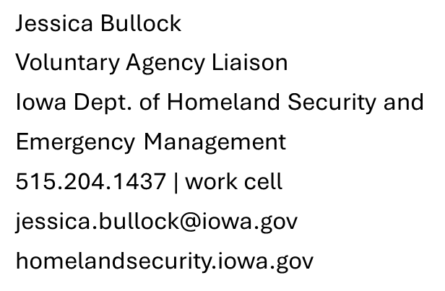

Contacts and Resources
Jamie Lane
Disaster Program Manager
Volunteer Iowa
515-402-2091
Jamie.lane@volunteeriowa.org
www.volunteeriowa.org

Slide 35
When A Disaster Strikes What happens in your community?
Notes:
Great opportunity to hear from audience about what happens in their community after disaster strikes.
Facilitated questions:
Who responds?
How do you know what to do if you want to help? Are you needed?
Where does that information come from?

